Slide 1
QCD lectures, 1 and 2: building and testing QCD
Samir Ferrag, James Ferrando
University of Glasgow

Slide 2
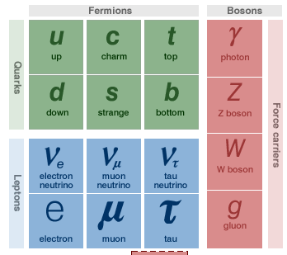
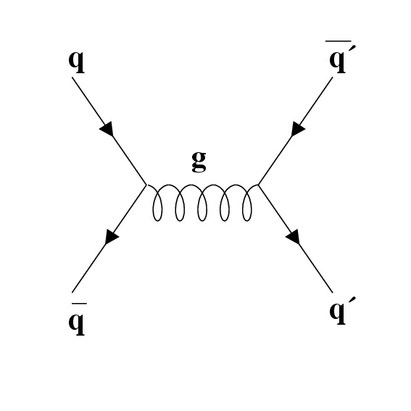
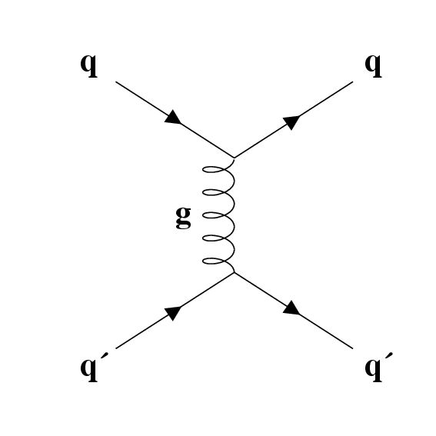
Introduction
4 Interactions: Weak, Electromagnetic, Gravity, Strong
Strong interaction posited to account for cohesion of nuclei
Must be stronger than EM
Must only be effective over short distances
Today, strong interactions are well described by Quantum Chromodynamics (QCD)
QCD concerns the Quark sector and the interactions are mediated by 8 gluons…
1930
1940
1950
1960
1970
Yukawa Theory
Quark Model
SU(3) in QFT
Parton Model

Slide 3
Lecture 1-2: Building and testing QCD
Historic
Yukawa model, Quark Model, Parton Model, QFT
Constraints for a strong interaction theory
QFT and SU(3)_{C}
QCD phenomenology: Predictions to test
Jets as a way to look at quarks and gluons
Quarks, gluons and triple gluon vertex
Quark and color species
Scaling violation
SU(3) and Non Abelian QCD
General way to look at jets
σ_{S} measurements
now
This afternoon

Slide 4
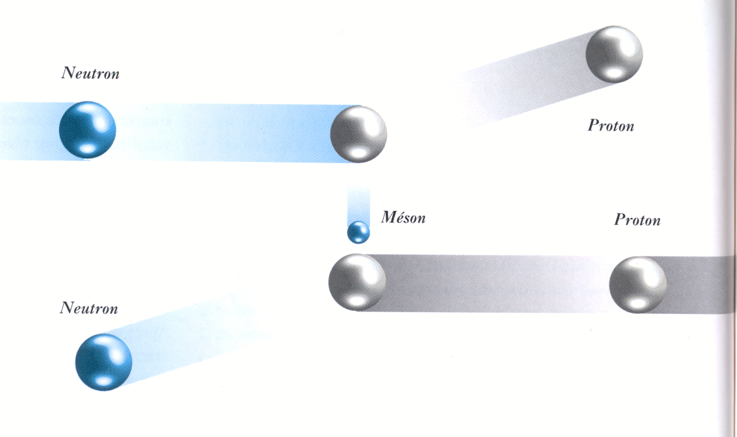
Yukawa theory 1934
Modeled like QED
Use Massive (~100 MeV) gauge boson to account for finite range
Ideal candidate π-meson discovered in cosmic rays in 1946
made renormalisable field theories where nucleons interacted with each other via the exchange of pions, conserving isospin + strangeness
perturbation expansions of strong interaction theory broke down. To make any prediction from the theory, one must sum the whole series, which is not possible.

Slide 5
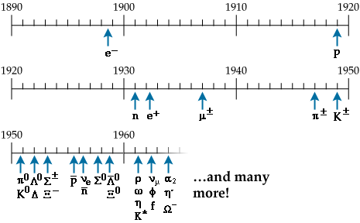
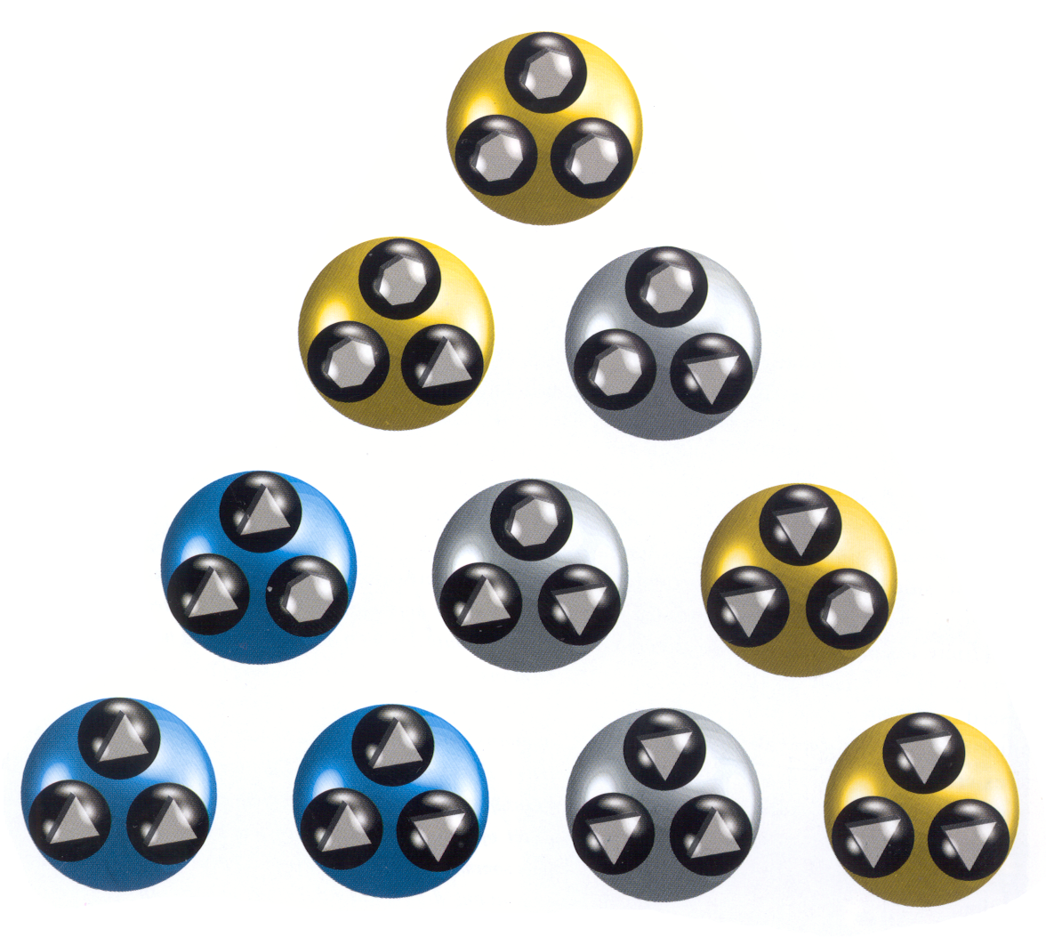
Ace and Quark Model
The big number of particles indicates a possible more fundamental structure of matter
In 1964 Gell-Mann and Zweig independently proposed that hadrons were composite particles built from three basic blocks now known as up, down and strange
Mesons formed by qq, nine combinations available, octet and singlet
Baryons formed by qqq, in SU(3)_{F} only decuplets, octets and singlets available
The proposed particles had very unusual properties:
spin 1/2 and baryon number 1/3
u and d form an isospin doublet with 0 strangeness
s an isospin 0 singlet with unit strangeness
non-integral charge: Q_{u} = + 2/3, Q_{d,s} = - 1/3
sss
Up
Down
strange
Strangeness (s)
(u) Isospin (d)
uuu
ddd

Slide 6
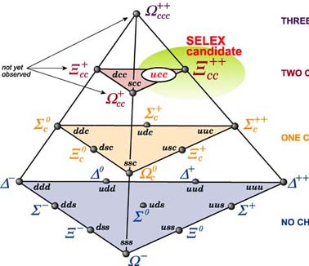
Quark Model with 4 quarks
Charm (c)
(u) Isospin (d)
Strangeness (s)

Slide 7
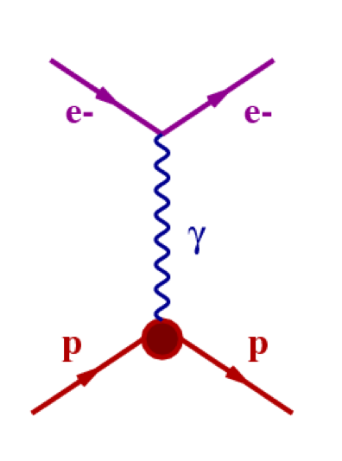
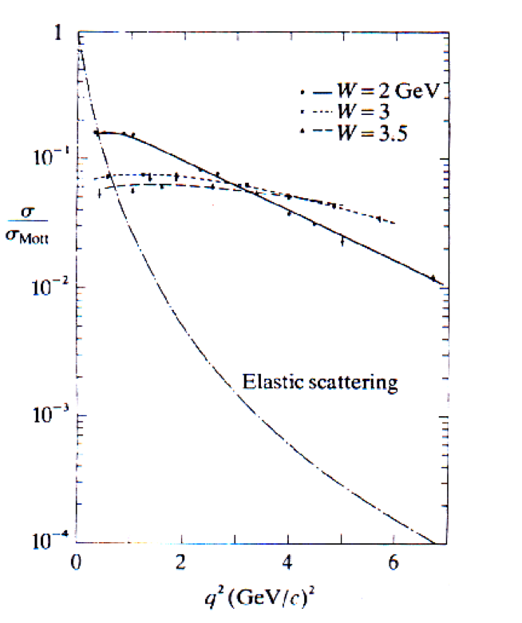
eP scattering
Elastic ep scattering can be understood entirely in terms of QED as the exchange by a structured proton and a electron of a single γ.
First measurements showed that at large angles in ep scattering was much smaller than in ee scattering
Electrons seemed to act as ‘hard’ objects, bouncing off one another
Proton seemed to be a diffuse large object exerting a smaller impulse on passing particles
Inelastic ep scattering was also thought to be mediated by single photon exchange between proton and electron, and it was thought that the most important process would be resonance production
Analysis of the data at low electron scattering angle showed the expected behavior
At large angles there remained a large measured cross section, despite the disappearance of individual resonance peaks
The inelastic ep cross section was behaving as though the proton contained hard, point-like scattering centres
In the late 60s, scaling was observed at SLAC (22 GeV linear electron accelerator

Slide 8
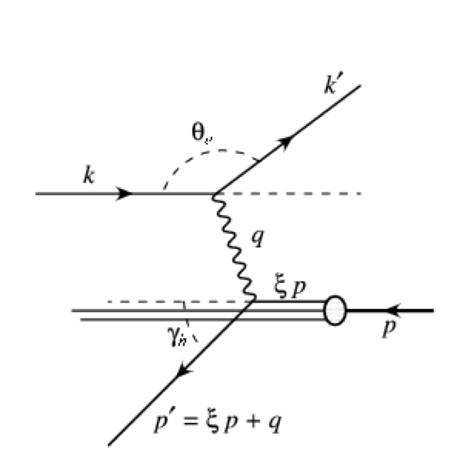
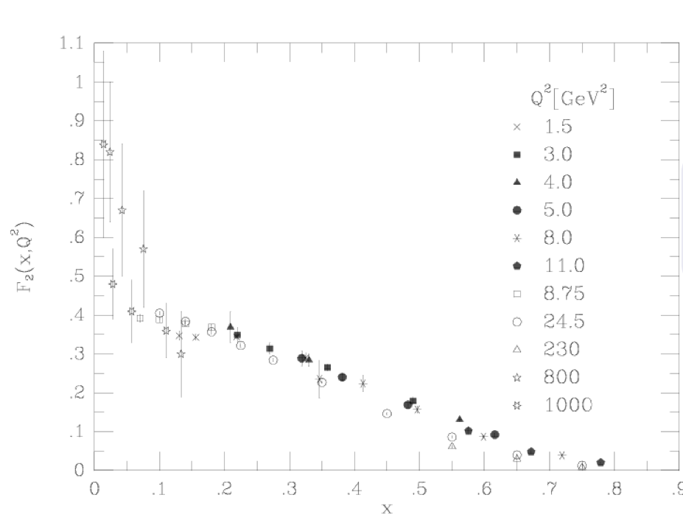
Scaling in inelastic ep scattering
In high energy ep → X we define variables:
Structure functions, F₁ and F₂ are include our ignorance of the proton structure in describing the interaction cross section:
F₁,F₂ are functions of x,Q². Bjorken predicted that for Q²→∞, and x fixed the F_{i} depend only on x
Bjorken scaling → γ scatters off (charged) point-like proton constituents.

Slide 9
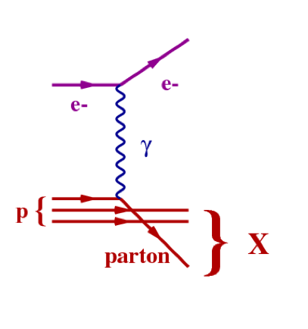
Parton Model
Parton Model developed by Feynman to account for scaling
Proton constituents are called partons
Bjorken scaling → γ scatters off (charged) point-like proton constituent
Partons are regarded as free over the time of collisions
Deep Inelastic Scattering (DIS) in the Parton Model is a single γ exchange between the e and a parton
F₁, F₂ measure the momentum distribution of the charged partons within the proton in terms of x (momentum fraction of proton)
Parton Model predicts scaling

Slide 10
Link to the Quark Model
Successes:
Provides a method to deal with strong interactions by focusing on their effect on parton distributions
With parton distributions, electron-hadron processes became calculable in terms of first order QED processes
Questions:
What are the partons? Are they Quarks?
Partons must be Quasi-free to account for scaling, but constituent quark model requires strong inter-quark forces
Need an extra Quark-Parton Model assumption to stop quarks flying out of the proton after scattering. (No quarks observed in remnants of collisions)
Feynman showed that scaling would be observed in DIS irrespective of parton nature

Slide 11
Quark-Parton Model (QPM)
We can express the contribution of each quark to F_{i} using the fact that the interactions are from QED:
q(x) is the probability of finding a parton with momentum fraction between x and x + dx
Relative magnitudes of F₁ and F₂ are determined by spin.
R = F₂ −2xF₁ was measured as approximately 0 (Callan-Gross relation), as would be expected in the spin 1/2 case
3 quark (uud) model of protons overestimated the measured size of the structure functions by approximately 2
Break down quark component into:
“Valence” : minimum SU(3) composition of the hadron
“Sea” : SU(3) singlet cloud containing indefinite number of quarks

Slide 12
Sea quarks & Sum Rules from QPM
Probed at a scale Q², sea contains all flavours with M << Q
at Q ≈ 1GeV appropriate Parton Density Functions are:
u(x) = u_{V} x + u_{S} (x), d(x) = d_{V} x + d_{S} (x), s(x) = s_{S} (x)
expect that u(x) = d(x) = s(x) = s(x)
Expect the proton momentum sum rules, to hold:
It was measured that:
50% of proton momentum is not carried by quarks

Slide 13
On the road to QFT
In QFT no realistic interacting theory predicted scaling
Success of QPM model and scaling in DIS explained with demonstration of Asymptotic Freedom in gauge theories
Gauge theories are invariant under local transformations of fields, thus predictions are unchanged by such transformations
Asymptotic Freedom means that at high momenta gauge theories behave as free, non-interacting field theories
important steps:
1972: Gross & Coleman - no renormalisable field theory except gauge theories, could account for scaling
1973: Politzer & Wilczek - asymptotic freedom of gauge theories
1973: Gross & Coleman - no theory without gauge fields asymptotically free
A field theory of the strong interaction must be a gauge theory

Slide 14
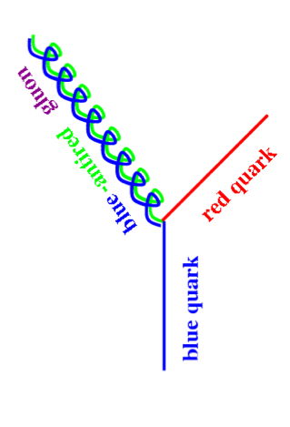
Gauge theory for the strong interactions
Assume the fundamental gauge fields are quarks interacting via exchange of gauge vector fields (gluons)
Since quarks are fermions, total wave function must be anti-symmetric under quark-interchange. Wave functions of quarks were represented by three components
Which is symmetric overall under exchange of quarks.
Solution : Introduce a new Quantum number → Colour
Gauge theory of SI describing interactions between quarks and gluons within SU(3)_{C} group of colour is known as Quantum Chromo Dynamics (QCD)
3 Colour charges, conserved at each vertex, used:
quarks are singly charged.
gluons doubly charged.

Slide 15
QCD Langrangian

Slide 16
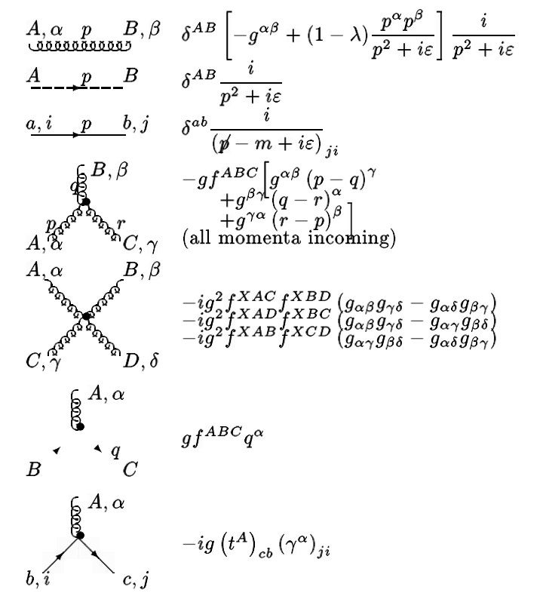
QCD Feynman Rules
Gauge fixing term
λ=1 Feynman gauge
λ=0 Landau Gauge
In non abelian theories, covariant gauge fixing term must be supplemented by a Ghost term which cancels unphysical degrees of freedom of gluons which would otherwise propagate in covariant gauges

Slide 17
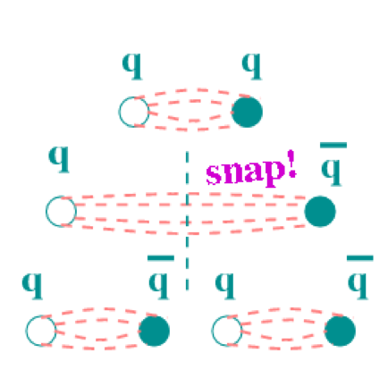
Confinement
QCD exhibits the two most important properties of quark and gluon interactions: asymptotic freedom and confinement
Confinement offers a solution to the problem of the lack of observation of free quarks
Since gluons also carry colour charge, they can couple directly to other gluons
The potential energy required to separate quarks increase linearly with their distance
Quarks and gluons are only seen in colourless hadrons
Large amounts of energy to break up hadrons
This energy is needed to create quark-anti-quark pairs

Slide 18
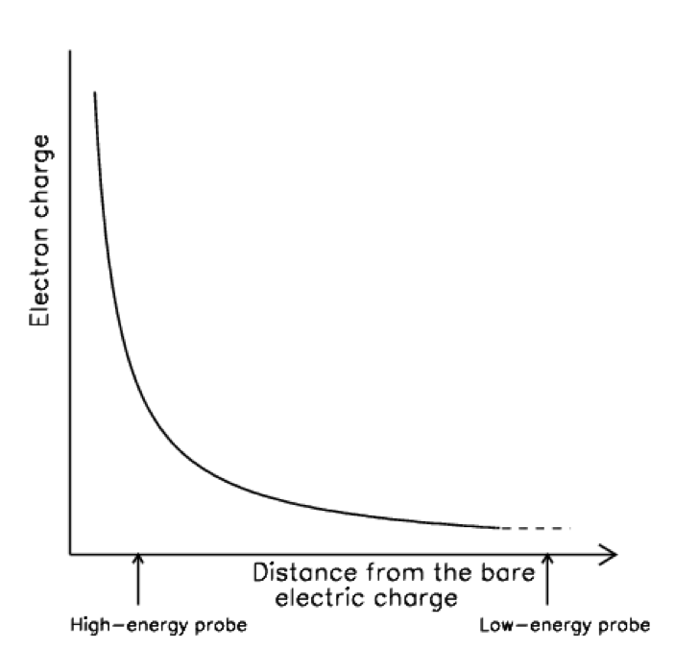
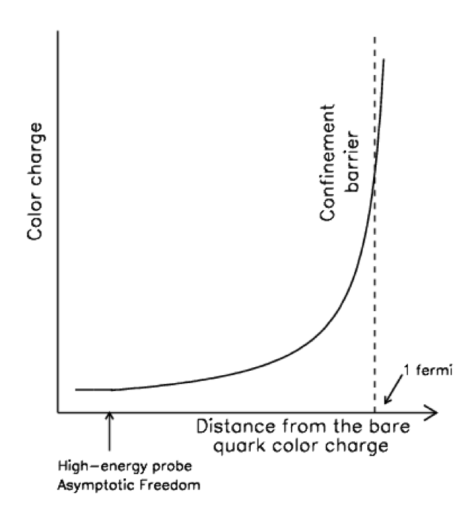
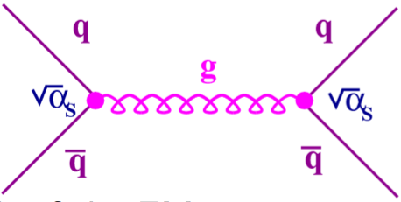
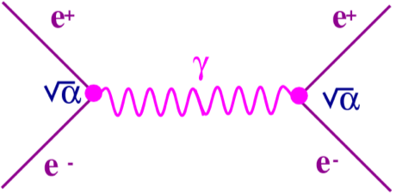
Asymptotic freedom in QCD
α is a measure of the strength of the EM interaction. α = e²/4π
In QED, α gives the probability of emitting a photon
the charge seen depends on distance from the particle (running)
Due to screening, α is small at long distances, this is the scale at which perturbation theory works→ When very far from each-other charges behave as free non-interacting particles
α_{S} strengh of strong interaction α_{S} = g_{S}²/4π, g_{S} is the color charge
In QCD, α_{S} gives the probability of emitting a gluon.
The color charge seen depends on distance from the particle (running)
Due to anti-screening, α_{S} is small at short distances, this is the scale at which perturbation theory works → When very close together, partons behave as free non-interacting particles

Slide 19
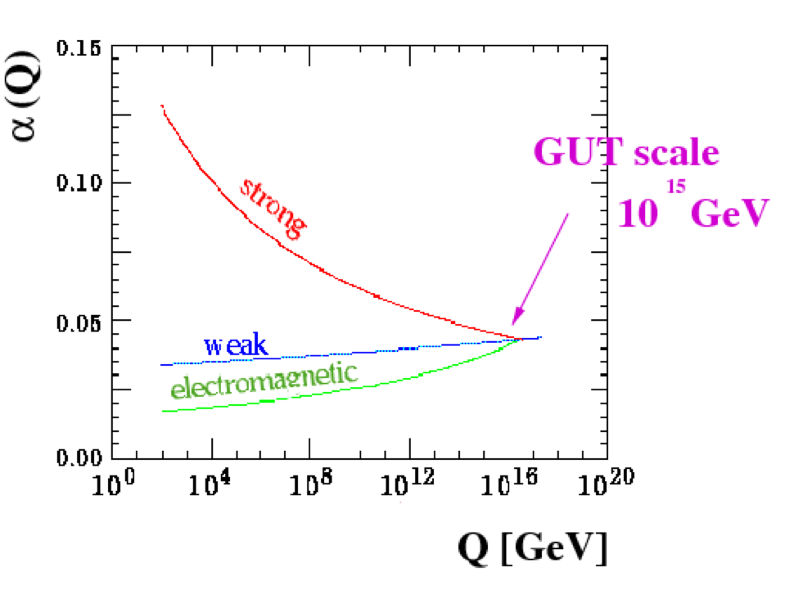
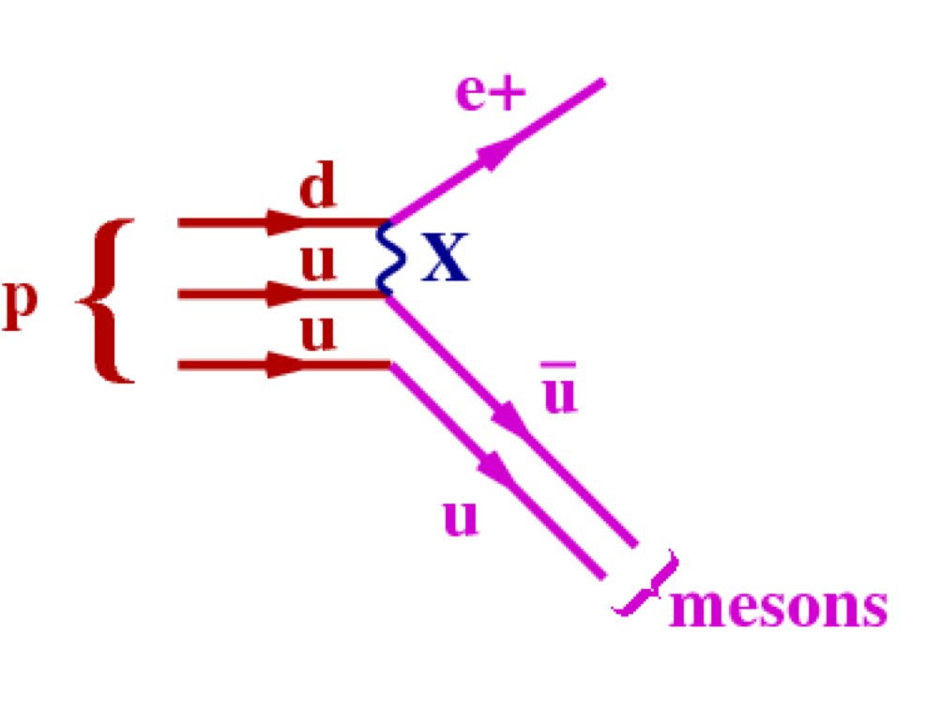
Running couplings and Grand Unification
We expect all couplings to merge at a very large (10¹⁵ GeV) energy scale
At this stage a Grand Unification Theory (GUT) would unify the strong, weak and EM interactions, making them all aspects of the same interaction
Several models have been proposed, none are entirely satisfactory, so far
GUT’s predict lifetime of 10³¹ years for the proton
Hitherto there has been no detection of proton decay

Slide 20
Tests of QCD phenomenology
To test the validity of the candidate theory, it’s predictions must confront experimental data.
QCD phenomenology:
Quarks & Gluons: Since quarks and gluons cannot be seen in isolation, we should only directly observe hadronic jets
Scaling Violations: due to interacting parton. F²(x,Q²) should increase with Q² and at small x and should decrease at large x
Gluon Self Coupling: Evidence for a ggg vertex should be observed
3 Colour States per Quark: Cross sections should yield evidence that there are 3 colour degrees of freedom for each quark in a final state and should be compatible with non-abelian group SU(3)_{C}
Running of α_{S} : α_{S} should decrease with increasing Q²

Slide 21
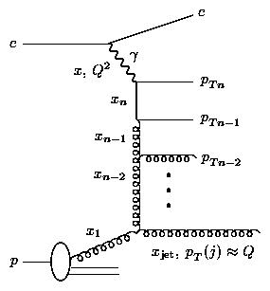
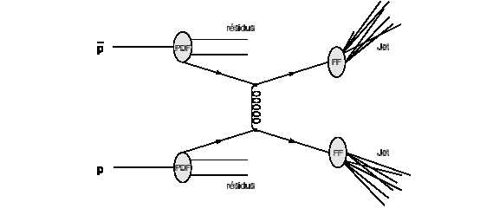
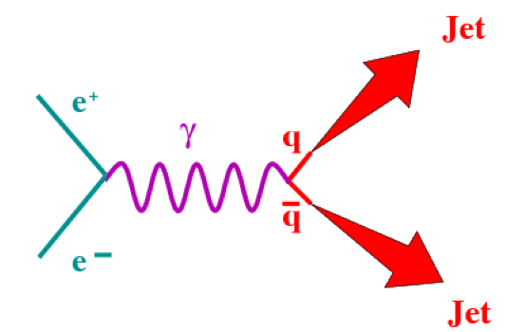
Collision environment to test QCD
electron-electron
--
--
FSR ✓
electron-proton
PDF (h,γ) ✓
ISR ✓
FSR ✓
proton-proton
PDF (h) ✓
ISR ✓
FSR ✓

Slide 22
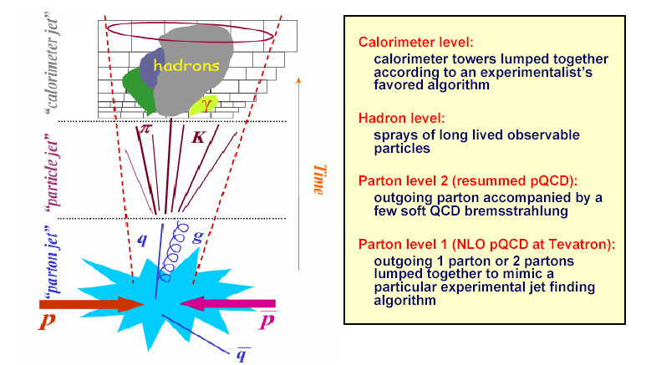
Jets matched to partons (I)
QCD confinement and Asymptotic Freedom tells us that we can’t see free quarks and gluons
The quarks radiate gluons and/or hadronise
The gluons split into quark/anti-quark pair or radiate other gluons
The hadronised quarks decay into other hadrons and so on
The result is a collimated “jet” of charged and neutral particles
→ observing a jet is a way to observe the quark and the gluon
Sometimes*, only small corrections are needed to compare experimental data to parton level calculations. Kinematics of jet production correspond closely to the kinematics of partons in the hard scatter ( “Local hadron-Parton Duality ” – LHPD)
* it’s not always the case, see below for more general jet physics

Slide 23
Jets matched to partons (II)
The collision of very high energy electron + positron beams offers an opportunity to look for direct evidence for quarks and gluons
Photons and (Z bosons) are produced in e⁺e⁻ collisions Can produce qq
qq pull apart producing 2 jets travelling in the same direction as the quarks and approximately opposite to each other
If one of the 2 quarks radiate a hard gluon, the gluon will form a 3rd jet
_
_
_
2 jet event
3 jet event

Slide 24
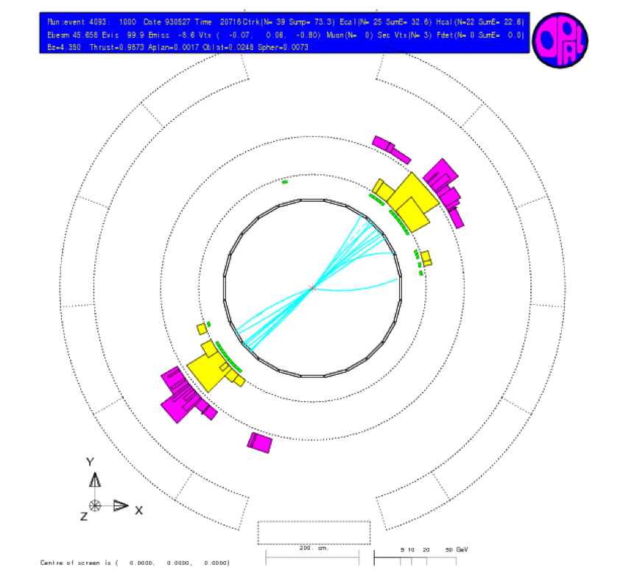
2-jets to observe the quarks
1st observation of back-to-back dijet events in e⁺e⁻ → qq at SPEAR 1975
The collision of very high energy e⁻ e⁺ beams offers an opportunity to look for direct evidence for quarks
Back to back collimated bunches of tracks from charged hadrons seen in the central tracking detector
Back to back hadronic clusters in the calorimeter

Slide 25
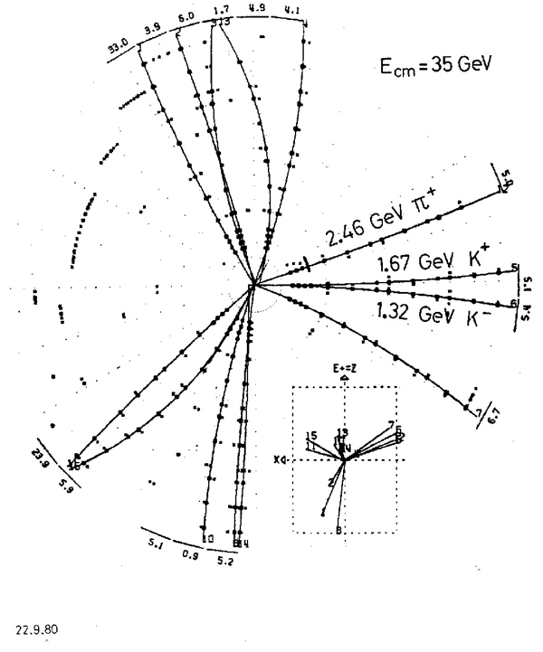
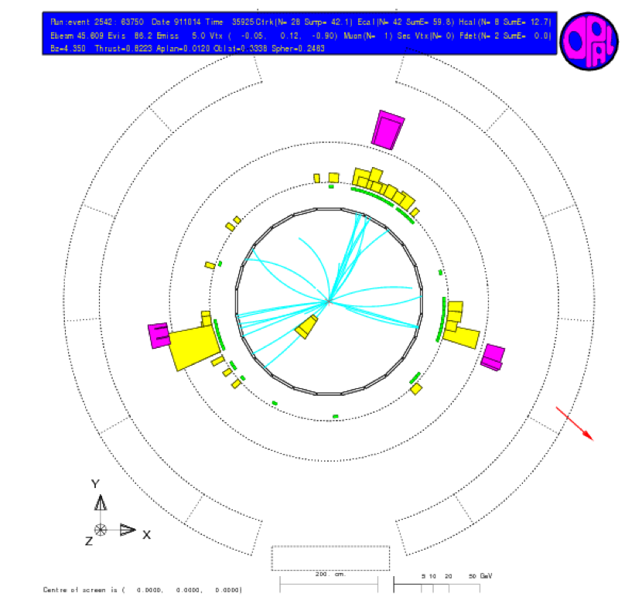
3-jets to observe the gluon
High order correction to e⁺e⁻ → q¯q gives events with 3 jets in the final state
Jets are coplanar to conserve momentum
first direct evidence for gluons by observation of 3 jet events at PETRA in 1979

Slide 26
3rd jet from a higher order correction
The leading order cross section
Where s is the C.O.M. energy squared, is modified at O(α_{S} ) by gluon emission diagrams
the modified cross section is:
This can be written in terms of transverse momentum (p_{T} ) between the q and q
For fixed p_{T} the cross section increases with increasing s

Slide 27
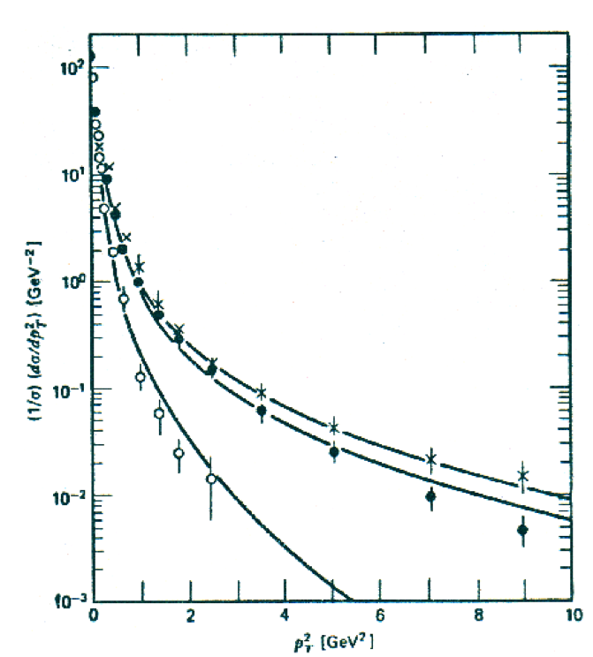
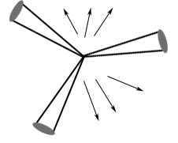
Hadron activity due to gluons
Hadrons in Quark-Gluon interaction
)
p_{T} is non-zero only when there is gluon-emission.
More hadrons are produced in the Gluon-quark than in the quark quark side
The hadrons from one of the quarks should also have large p_{T}
Measurement of the p_{T} distribution w.r.t. the thrust axis of hadrons at different s at PETRA
For fixed p_{T} the distribution increases with increasing s
For s the distribution falls with increasing p_{T}
These measurements also confirmed the Lund String model for hadronisation
)

Slide 28
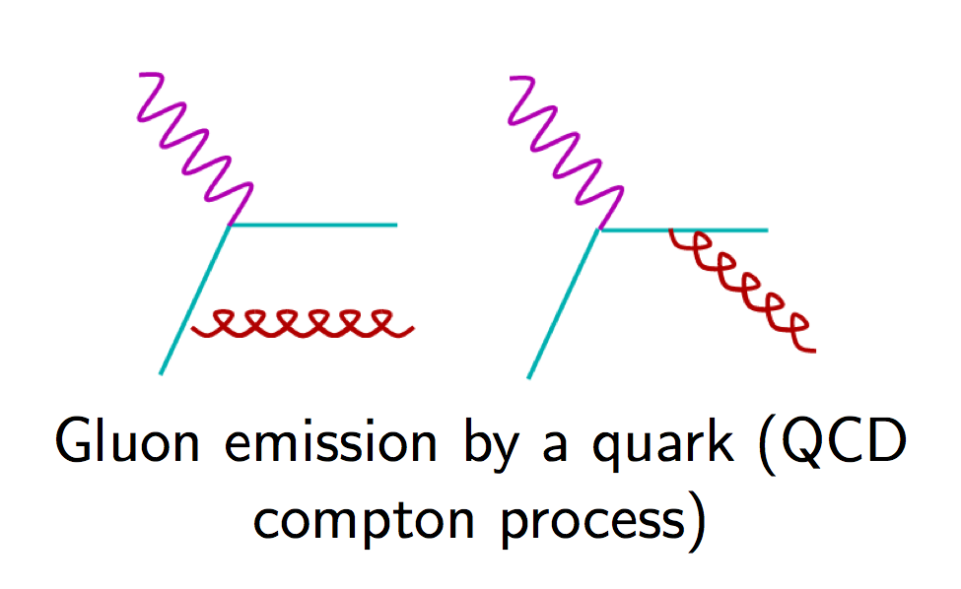
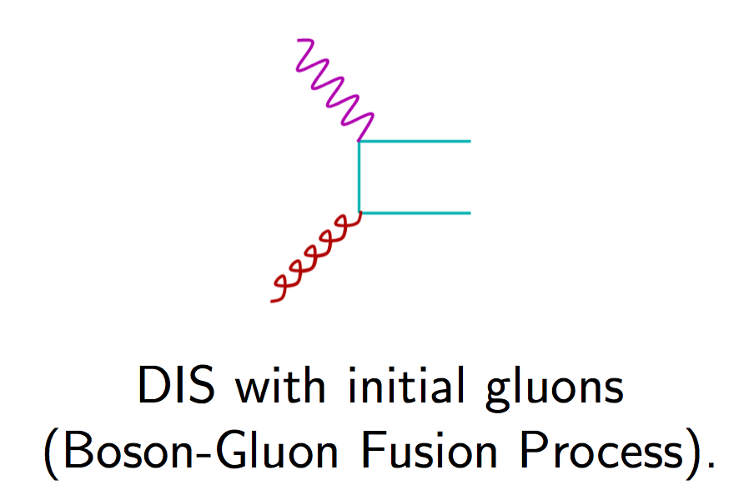
Scaling violation (I)
The QPM predicts exact scaling because it assumes free partons
QCD predicts that exact scaling is broken by gluon emission or gluon splitting
This give rise to terms:
∼ α_{S} lnQ²
which break scaling
Such logarithmic scaling violations are a property of gauge theories with point like fermion-vector boson couplings

Slide 29
Scaling Violation (II)

Slide 30
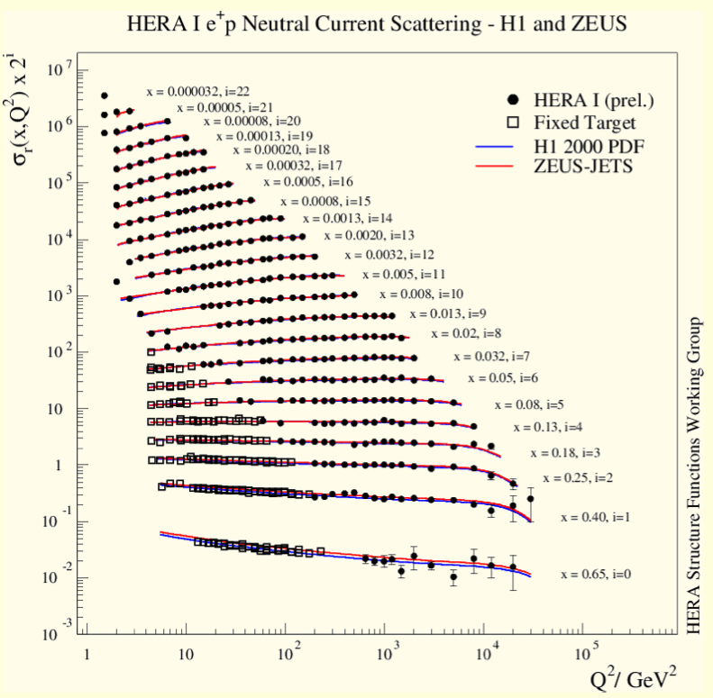
Scaling violation evidence
Plot showing measurements of F₂(x,Q²) in DIS from collider(ZEUS) and fixed target (E666,NMC,BCDMS) experiments
Here we see that F₂ is increasing with Q² for small x and decreasing at large x
Perturbative QCD describes the data well over 4 orders of magnitude in Q²
sensitive to gluons through scaling violations:

Slide 31
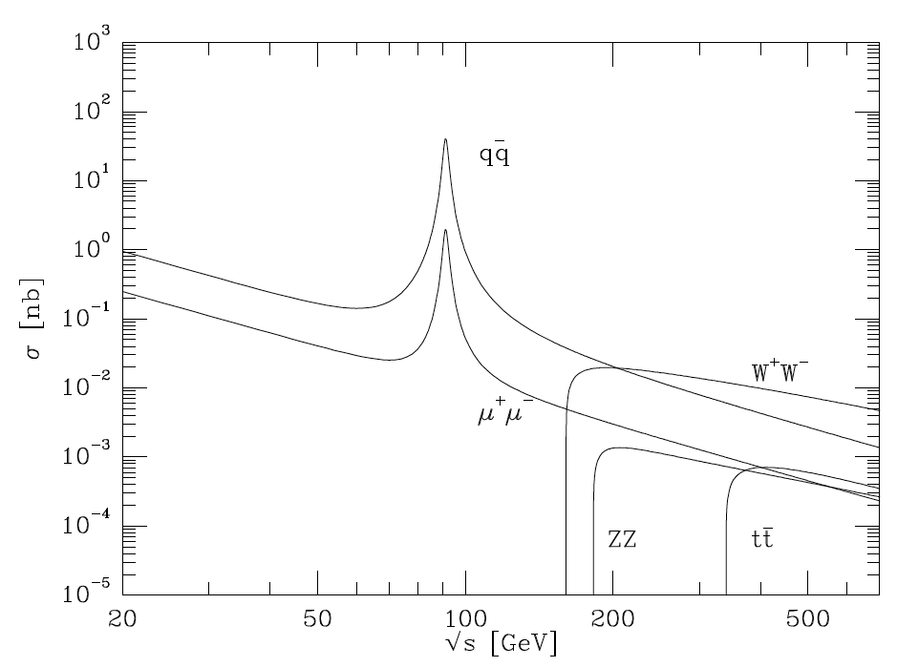
Measuring quark and color species (I)
Expect:
Well measured μ cross section makes it possible to confirm number, color states and electromagnetic charge of quarks

Slide 32
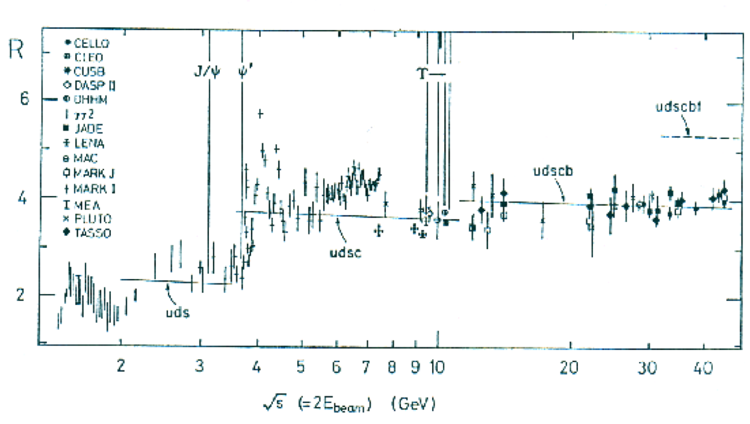
Measuring quark and color species (II)
R=2(u, d, s), 10/3(u, d, s, c), 11/3(u, d, s, c, b), 15.3(u, d, s, c, b, t)
→ n_{c} = 3

Slide 33
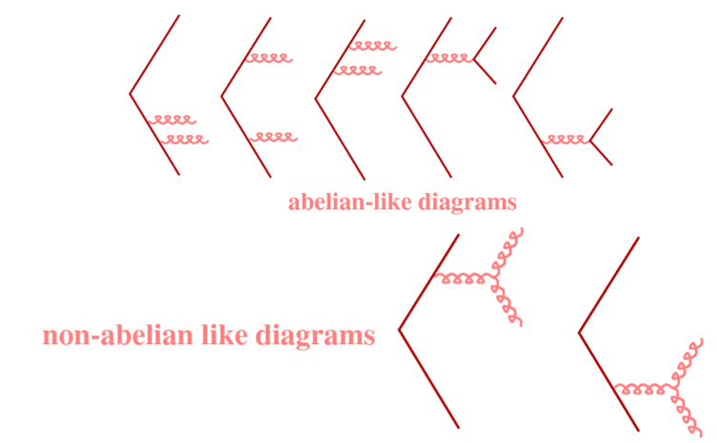
Triple gluon vertex (I)
QCD is based on the non-abelian SU(3) group which introduces self-coupling of the bosons. QED is based on the abelian group U(1)
Due to the gluon self-coupling, the ggg vertex should be observed in events containing at least 4 jets in the final state
Diagrams contributing to the cross section for four jet events

Slide 34
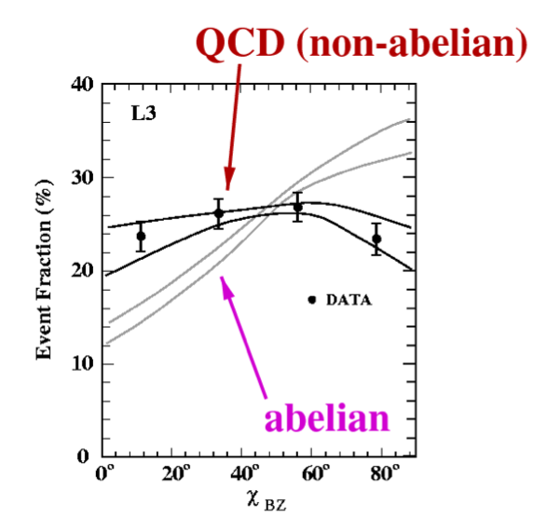
Triple gluon vertex (II)
4-jet events have been observed at LEP
Variables were devised to highlight the non-abelian nature of QCD in contrast to abelian theories such as [U(1)]3
Bengtsson-Zerwas angle BZ the angle between the planes defined by the two lowest and two highest energy jets
Nachtmann-Reiter angle NR, angle between the momentum vector of the differences of jets 1,2 and jets 3,4
Angle between two lowest energy jets
These have been measured at LEP
Data clearly favours non-abelian theory

Slide 35
Color factors and SU(3)_{C} (I)
Dynamics of a gauge theory are defined by commutation relations between its generators
In perturbative calculations the average and sum over all possible color configurations in the initial and final states lead to the combinatorial factors C_{A}, C_{F} and T_{F}
C_{A}, C_{F} and T_{F} are known as the colour factors and are the physical manifestations of the underlying group structure
in QCD they represent the relative strength of the processes q → qg, g → gg and g → q¯q
Simultaneous measurement of C_{A}/C_{F} and T_{F} /C_{F} at in e⁺e⁻ collisions has been made

Slide 36
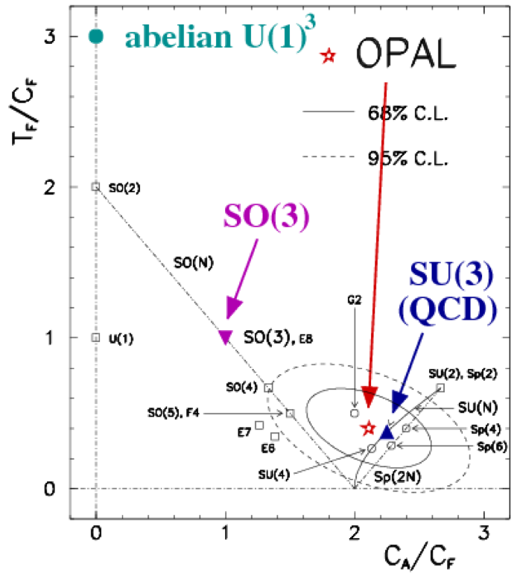
Color factors in SU(3)_{C} (II)
Group | C_{A}/C_{F} | T_{F}/C_{F}
SU(3) | 9/4 | 3/8
[U(1)]³ | 0 | 3
SO(3) | 1 | 1
Measured values
SU(3) is clearly favored

Slide 37
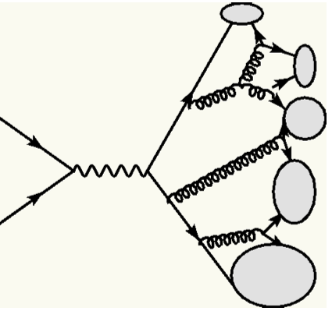
The ambiguous definition of a jet
]
]
]
Often, Jet objects can’t be associated to the hard process partons in a trivial way as when following the Hadron-Parton-Duality
Many observers may have different views and jet structures of the same QCD event
Quantitative measurements need quantitative jet definition. Some combination of energy flow objects will be used to form a jet, the kinematic properties of the jet object is defined in terms of these energy flow objects (i) as:
jet1
]
jet1
jet2
jet1
]
]
jet3
]
]
jet2
jet4
]
]
jet2
jet5
jet3
View 1
View 1
View 1
But how do we decide which energy flow objects are assigned to which jets ?

Slide 38
Jet Algorithms
Grouping of energy flow objects is performed by jet algorithms.
The jet is defined by an algorithm
Jet clustering algorithms should be:
Infrared and collinear stability -jet cross-section must not change if the original parton radiates a soft parton or splits into 2 collinear partons.
Close correlation with parton direction
Small hadronisation corrections
Small renormalisation scale uncertainty
Suppression of contributions from beam remnants if at hadronic colliders
few popular jet algorithms are the following:
The Cone algorithm
The KT or “Durham” algorithm
In the case of experimental results the jet algorithm input-energy-flow-objects used are final state hadrons, usually measured in calorimeter or tracking components.
In the case of ATLAS, these input objects are:
Towers : means calorimeter towers at EM scale
TopoClusters : means topological clusters. If calibration type is H1, using clusters at EM scale. Else if calibration is LC, using calibrated TopoClusters

Slide 39
Cone algorithm
Preclusters are identified using a grid in the − plane with a cell spacing of:
Δη^{gridcell} ~Δφ^{gridcell} ~ R/2
where R is the cone radius. Preclusters are defined by moving a 3x3 cell window around the grid. If the total transverse energy within the window is greater than a minimum energy requirement (1 GeV) then it is identified as a precluster.
A cone of radius R_{cone} is placed around the precluster, and objects within the cone are assigned to the cluster. Typically the cone radius is R_{cone} = 1.
The kinematics of the cluster are determined according to the snowmass convention
the previous two steps are repeated until convergence, or a maximum number of iterations is reached.
Clusters are considered complete jets, if they pass a minimum transverse energy requirement.

Slide 40
KT algorithm
For every pair of objects, a distance parameter dij is defined
with the radius parameter R being of order unity, and Rij the
distance between the two objects in the η−φ plane
For every single object the distance parameter to the beam is defined
d_{i} and d_{ij} are compared; if d_{ij} is smaller than d_{i} then objects i and j are merged according to the Snowmass convention. Otherwise, the object is considered complete and removed from further clustering.
The previous 3 steps are repeated on the remaining (combined) objects, until d_{i} < d_{ij}

Slide 41
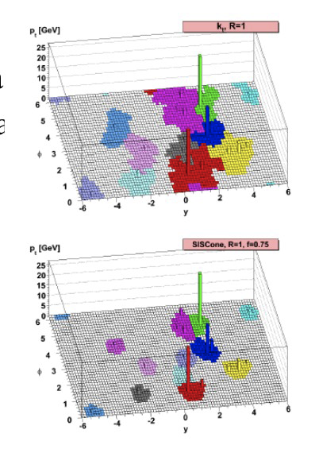
Jet algorithm comparison
Cone
Cluster together calorimeter towers by their angular proximity in (η,φ) space
Merging/splitting of overlapping cones is not infrared stable (at NNLO)
Ad hoc Rsep=1.3 match theory and exp.
Tevatron Run I legacy
KT
Cluster together calorimeter towers by their Kt proximity
Infrared stable (no spliting/merging)
No clusters left out → underlying event contribution unclear
Favored choice at hadron-hadron colliders

Slide 42
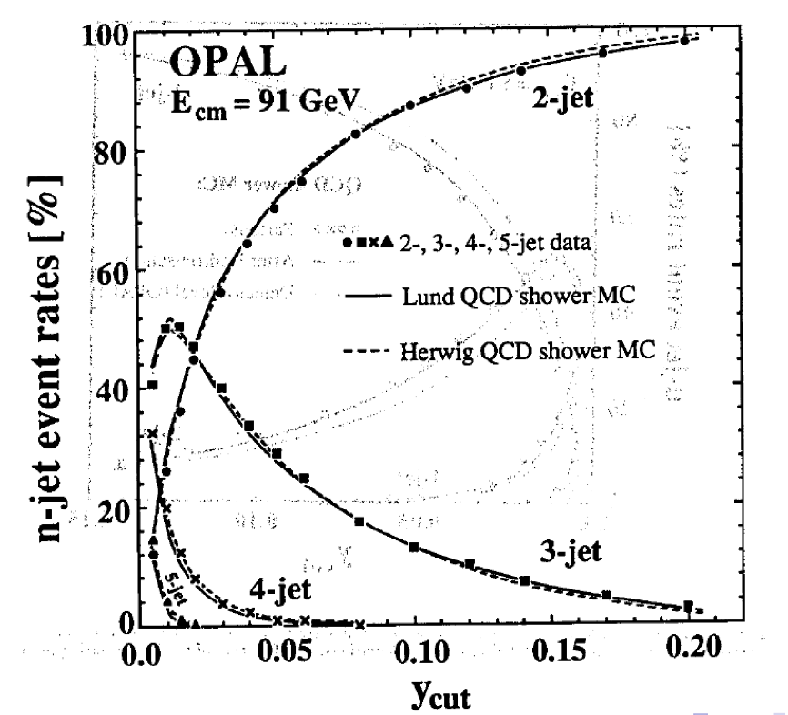
Jet Fractions
To define a fraction f_{n} of n-jet final states (n=2,3,4…), must specify the jet algorithm
For a given jet algorithm the fraction f_{n} depends on the jet resolution (here y_{cut})
Jets are not directly associated to partons in the hard process
Jet fractions were well simulated at LEP

Slide 43
Inclusive Jets at Tevatron
The same algorithm is run between the theory, JETRAD, and the Experiment

Slide 44
Event Shape Variables
Thrust
n for T_{T} axis
Thrust: longitudinal momentum sum
Broadening: transverse momentum sum
Measured with n set to the thrust axis, and photon axis
Jet Mass and C parameter: correlations of pairs of particles
Infra-red safe and excellent probe of pQCD – use current region of Breit-frame in ep.

Slide 45
α_{s} running: Renormalisation Group Equation (I)
The magnitude of the colour charge is modified by
antiscreening
The gluon propagator is modified to at Next Leading Order
Writing g_{s} as a function of g_{S0} at a given order gives:
We expect α_{S} will run with Q²

Slide 46
α_{s} running: Renormalisation Group Equation (II)
The scale dependence of an observable I in QCD is:
μ, a reference scale
At sufficiently low Q², the effective coupling becomes large The scale at which this happens is
Then:
α_{S} (Q²) decreases with increasing Q² and is small for short distance interactions
for Q² >> Λ², perturbative description in terms of quarks and gluons interacting weakly is possible
for Q² ~ Λ², the quarks and gluons are tightly bound in hadronic states and perturbation theory is inapplicable
The important parameter is not predicted by theory and must be determined by experiment. Recent measurements give MeV
Λ²

Slide 47
Measurement of α_{s} (I)
α_{S} is one of the fundamental parameters of QCD
The value of α_{S} is not predicted by theory
To obtain a high precision, the combination of many measurements must be performed to reduce the uncertainties
Measurements as precise as possible: using phase space where perturbative QCD predictions are least affected by theoretical uncertainties
α_{S} has been measured using different methods:
(DIS): Dijet cross sections in the Breit Frame at high Q² ,Inclusive jet cross sections in the Breit frame at high Q², (DIS) NLO QCD combined fit to inclusive NC DIS measurements (F₂) to obtain simultaneously the pPDFs and α_{S}…
(ee): Internal structure of jets, jet shape, τ decay…
(pp colliders): Inclusive jet cross section, W decay…
Independent methods give results consistent with each other and the world average

Slide 48
Measurement of α_{s} (II)
Method to determine α_{S} is usually to make a measurement which is sensitive to it and perform a fit with α_{S} as the free parameter
In recent years, much progress on the developement of process and observable independent algorithms that allow complete and analytical cancellation of soft and collinear singularities encountered in the calculation of the NLO cross sections
Restricting the measurements to a high-Q² kinematic region:
Avoids large renormalisation-scale dependence of NLO QCD dijet s at low Q2 (20-50 % for 10 < Q² < 100 GeV2)
Reduces uncertainty due to the pPDFs (esp. gluon density)
Improves the reconstruction of the boost in the Breit frame
Asymmetric cuts on E_{T} (jets) avoid infrared sensitive regions where behaviour of predicted by NLO QCD programs unphysical

Slide 49
α_{s} from dijets in DIS
The procedure to determine α_{s}(M²_{Z}) from the dijet fraction as a function of Q², R₂₊₁(Q²) was:
NLO calculations were performed using three sets of the MBFIT pPDFs and the value of α_{s} (M²_{Z}) assumed in each calculation is that of the PDF set.
These were used to parameterise the α_{s}(M²_{Z}) dependence of R₂₊₁(Q²) according to:
The value of α_{s} was then determine by a 2 fit to the parameterisation of the measured values.
this procedure correctly handles the complete α_{s} dependence on the NLO cross sections (explicit dependence on partonic implicit from PDFs) and preserves the correlation between α_{S} and the PDFs

Slide 50
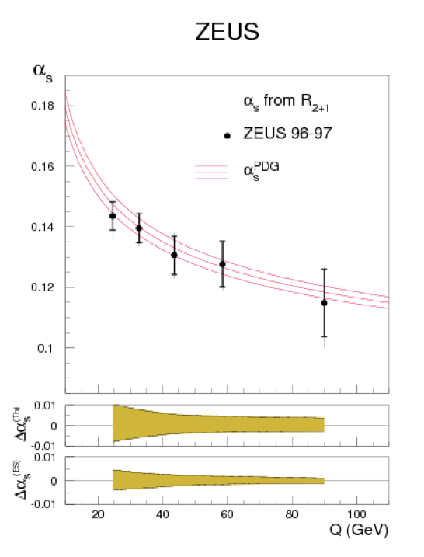
α_{s} from dijets in DIS
Study the scale dependence of α_{S} (Q²):
α_{S} extracted from R₂₊₁(Q²) in each Q² region
Results consistent with running of α_{S} QCD
Combined value of S extracted:
Theoretical uncertainties dominate:
Terms beyond NLO
Uncertainties from PDFs
Hadronisation corrections
Need improvement in theoretical calculations to obtain a more precise determination of α_{S} from the dijet cross section at high Q²
Measurement from inclusive jet cross section is similar method to dijet measurement with the same theoretical systematics

Slide 51
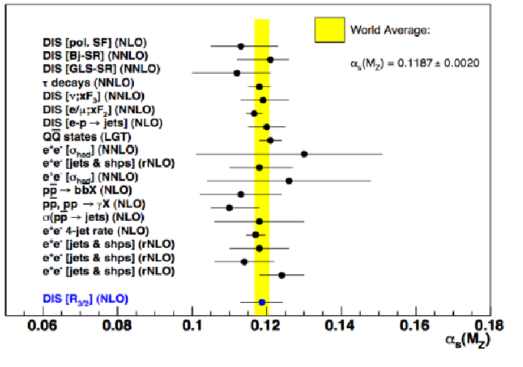
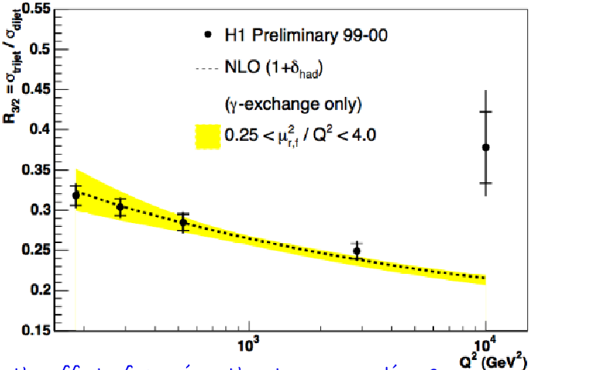
α_{s} from jet ratio
Ratio of 3-2 jets – cancel theoretical uncertainties

Slide 52
α_{s} from inclusive jets at tevatron (I)
The procedure to determine α_{S} (Q²) from the inclusive jet cross section as a function of E^{t}_{jet} is as follows:
QCD predictions for inclusive the cross sections use:
Where α²_{S}(μ_{R})ˆX (0)(μ_{F} , E^{t}_{jet} ) is the LO prediction for the inclusive jet cross
section and α³_{S}(μ_{R})ˆX (0)(μ_{F} , E^{t}_{jet} )k1(μ_{R,} μ_{F} , E^{t}_{jet} ) is the NLO contribution
Both α²_{S}(μ_{R})ˆX (0)(μ_{F} , E^{t}_{jet} ) and α³_{S}(μ_{R})ˆX (0)(μ_{F} , E^{t}_{jet} )k1(μ_{R,} μ_{F} , E^{t}_{jet} ) are calculated using the JETRAD program
The CTEQ4M PDF sets were used
Values of α_{S} were then determined by comparing the theory to the measurements

Slide 53
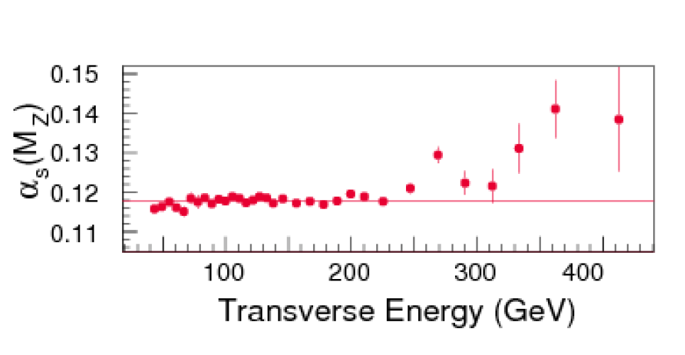
α_{s} from inclusive jets at Tevatron
From the measured dσ/dE^{t}_{jet} a value
of α_{s}(M²_{Z}) was extracted for each E^{t}_{jet}
region and in the region E^{t}_{jet} < 250 GeV,
A combined value was obtained equal to:
For E^{t}_{jet} < 250 GeV, good agreement with the world average
Behaviour at high E^{t}_{jet} is a direct reflection of the excess observed
in dσ/dE^{t}_{jet} → This discrepancy may be explained by an enhanced gluon content at high x in the pPDFs
Back to this using CTEQ6 & PDF uncertainties in the next lecture
Experimental and theoretical uncertainties are of the same order, both need to be improved to improve measurement

Slide 54
α_{s} from τ decay

Slide 55
α_{s} from W production
Some of the best understood processes in hadron-hadron collisions are vector boson and vector boson + jet production
From the ratio of these two cross sections UA1 and UA2 respectively Obtained:
Precision much less than other methods

Slide 56
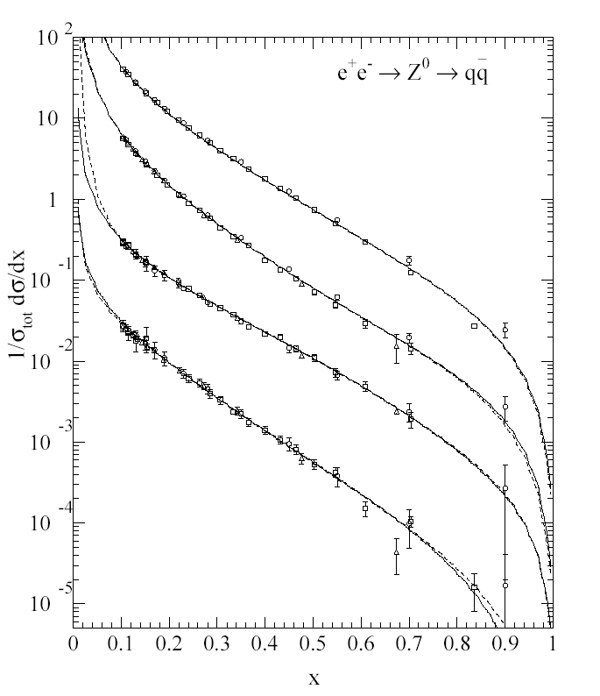
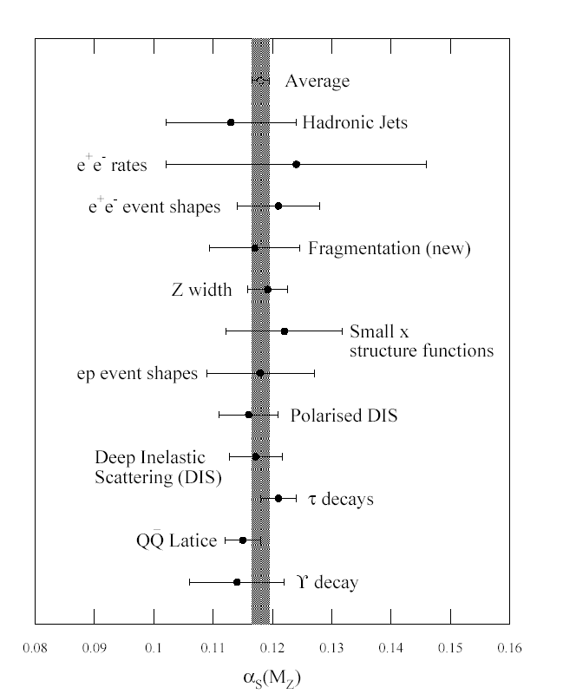
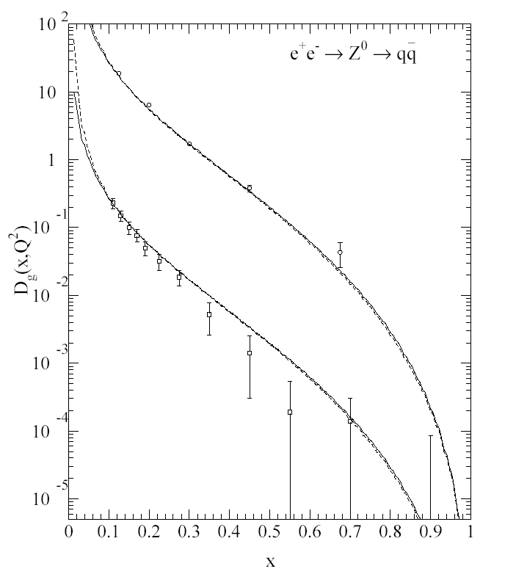
Extract α_{s} from fragmentation functions
π⁺⁻
Κ⁺⁻
p,p
Convolute NLO with data-derived
quark and gluon fragmentation functions
to extract α_{s}

Slide 57
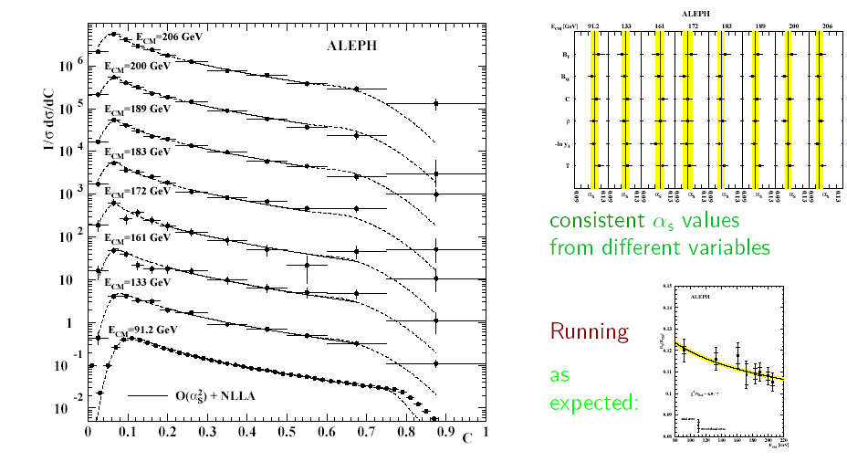
α_{s} from Event shape at LEP
E
sqrt(s)
variables
Consistent α_{s} from
6 different variables
Running

Slide 58
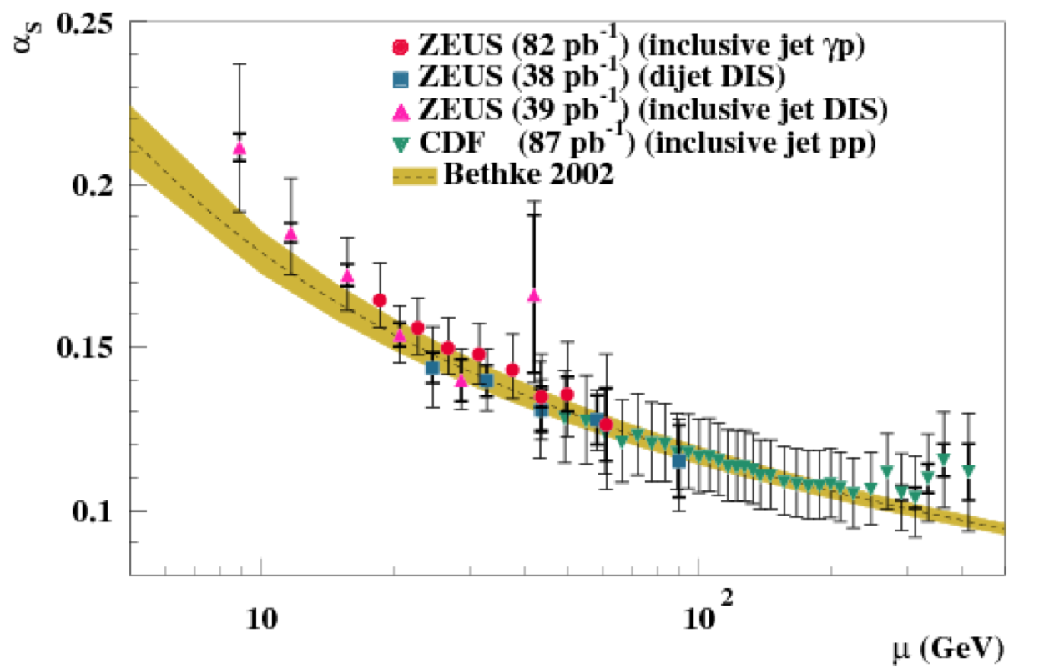
As running
2005

Slide 60
Determination of α_{s}
NLO QCD fits to structure function
data provide most precise determination
from DIS data.
Large theoretical
error outsanding .

Slide 61
Simultaneous extraction of α_{s} of α₀
Reasonably good
agreement over many
different variables

Slide 62
Conclusion
Historically, many models and theories have been developed to describe strong interactions
QCD, which is based on the gauge group SU(3)C, is the theory of the strong interactions in the Standard Model
QCD have been extensively tested at colliders:
Jets as quarks and gluons due to Confinement and asymptotic freedom
Non abelian SU(3)_{C} through event shape and color factors
Asymptotic freedom and α_{S} measurement using different processes: jets, event shape, DIS, W, τ
Nobel prize in 2004
Jets should not be always associated to parton in the hard process. Jets are defined by the jet algorithm which should be confronted to the theory

