Slide 1
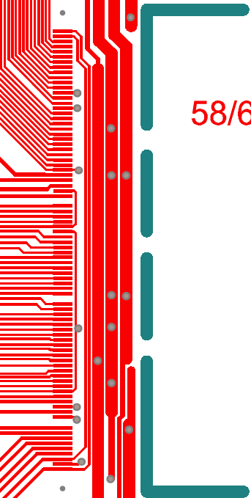
REG2IN
Analogue/VDDA/REG2OUT
REG1IN
GND
Digital/VDDD/REG1OUT
1
10
20
30
40
50
60
70
80
Notes:
Required bond pads to operate the FE_I4B with direct powering (Not using the on chip LVDOs)

Slide 2
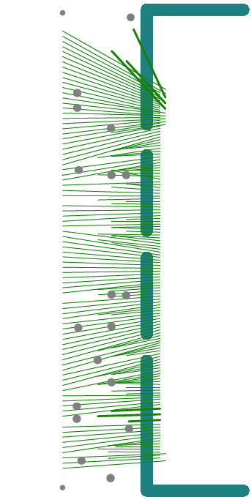
Notes:
Overlay of the bonding wires and the bond pads for a full chip bond with on chip LVDOs and all the FE-I4B bond pads connected

