Slide 1
Pixel module assembly tooling
Liam
(Thanks to Kirk)

Slide 2
Linear slide
Base system, will need two versions:
one for glue application
one for positioning the flex on the quad
Alignment dowels
Will also have micrometers for aligning flex to module
Head clamp
Vacuum base for holding chucks in place
Vacuum stub for base
Each chuck, quad, flex, flex pickup and glue, also has a vacuum fitting

Slide 3
Weight for flex gluing

Slide 4
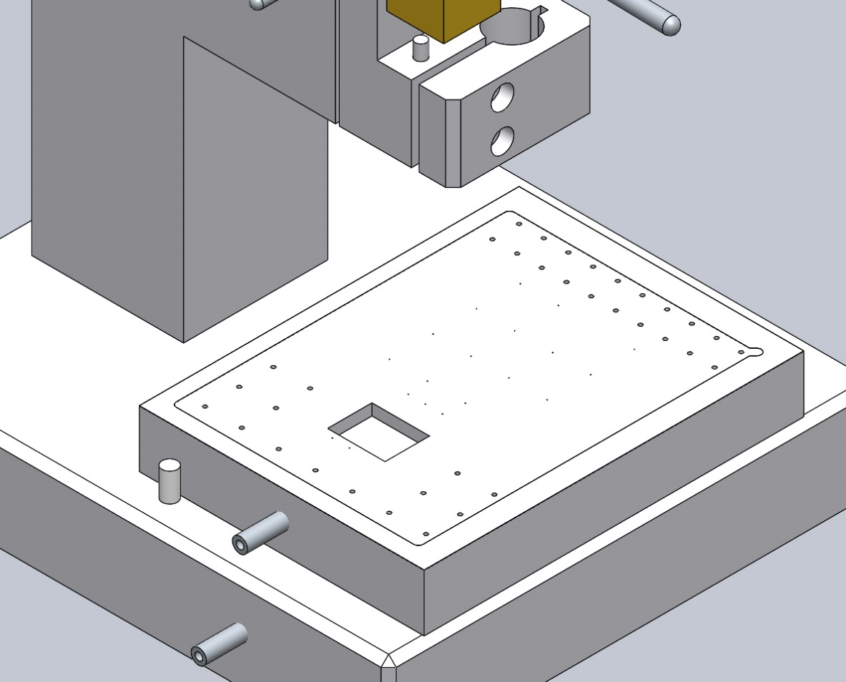
Larger holes for frame area
Shim for positioning made from 50μm stainless
smaller holes for Flex body area
Cutout for the connector

Slide 5
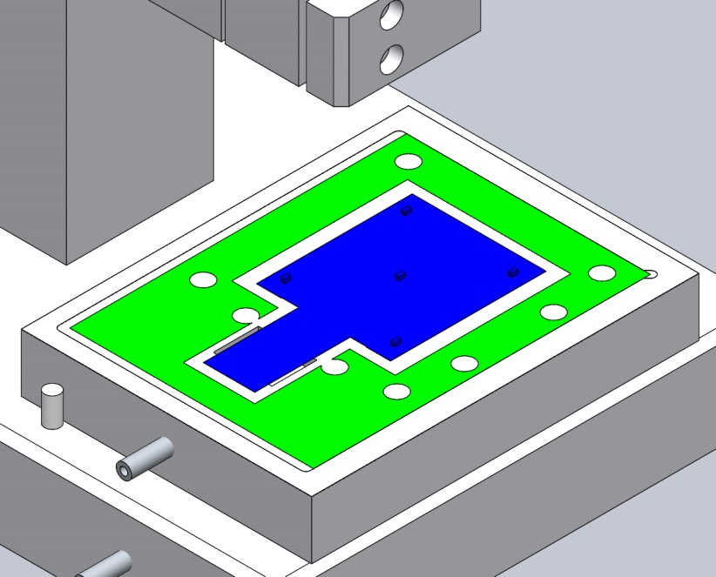

Slide 6
Vacuum holes for the frame and the tab
Cutouts for components (heaters in this case)
Channel 0.5 mm from the edge of the flex 0.2 mm wide

Slide 7
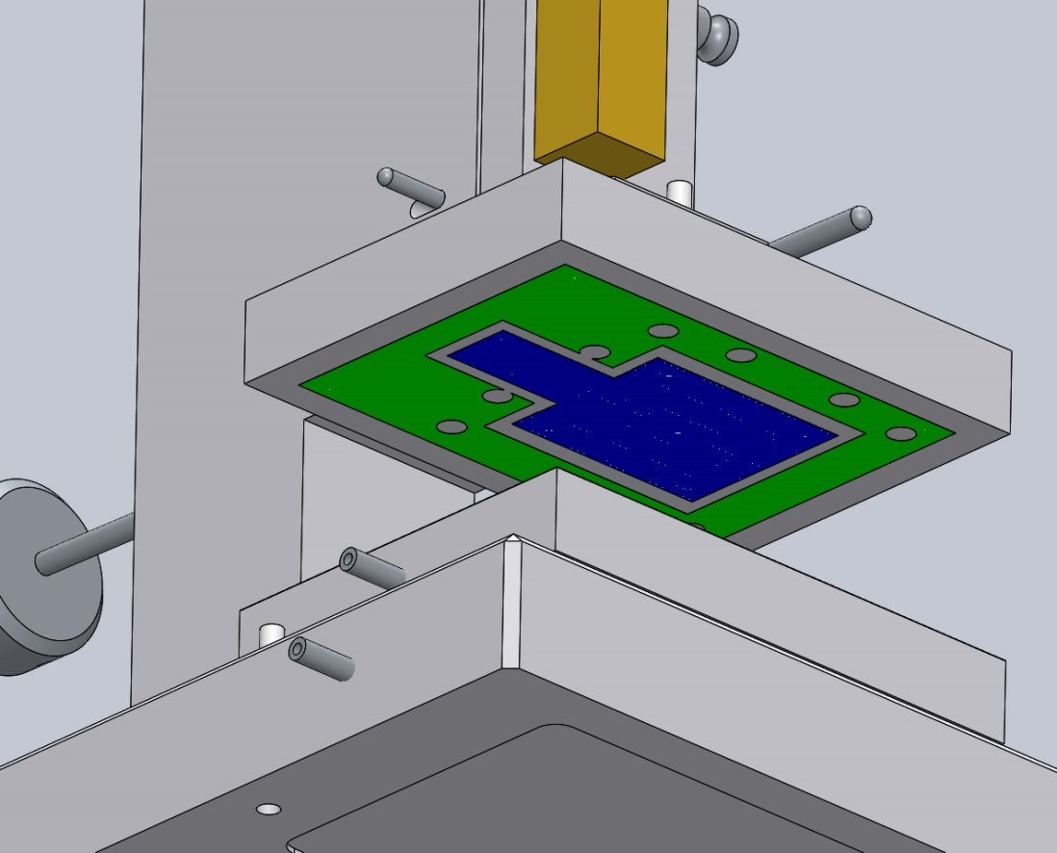

Slide 8
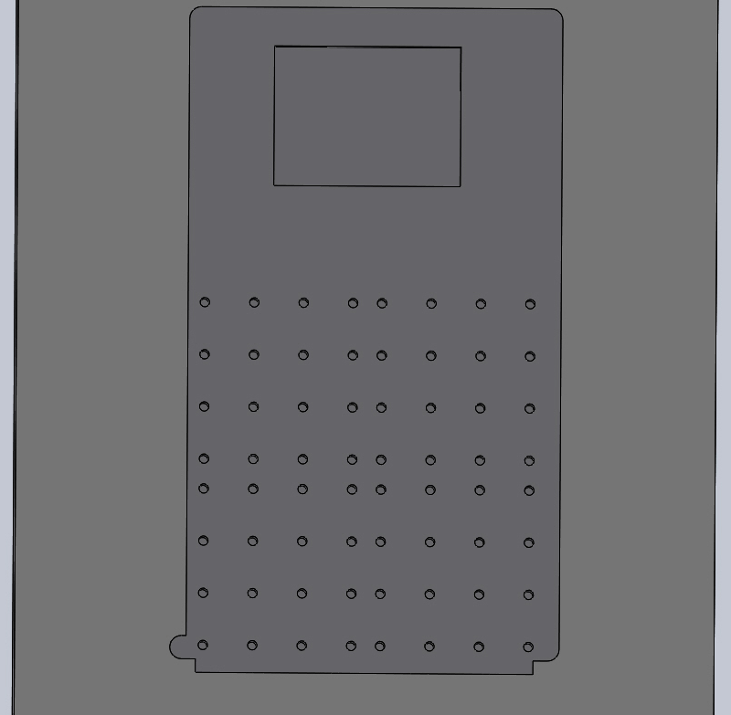
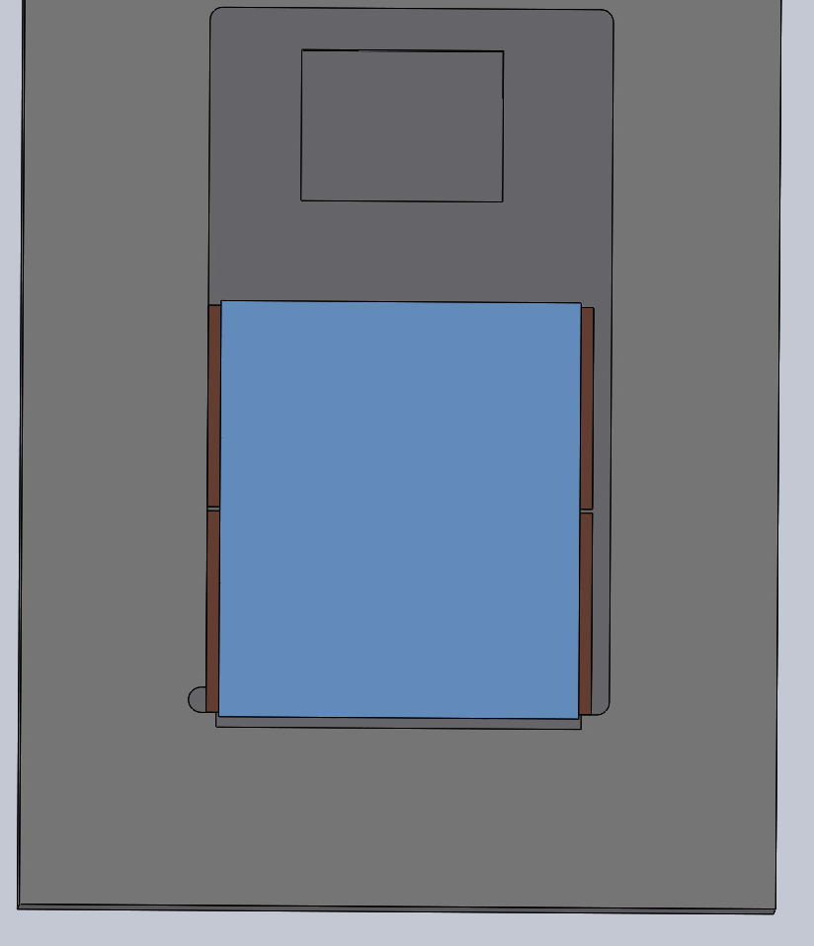
Cutout for connector
Vacuum hole pattern for each chip
Alignment of quad on chuck allows for thinner chips

Slide 9
Glue stamper head with rubber stamp held on by vacuum
Glue reservoir on the base
Applying glue to the stamp head

Slide 10
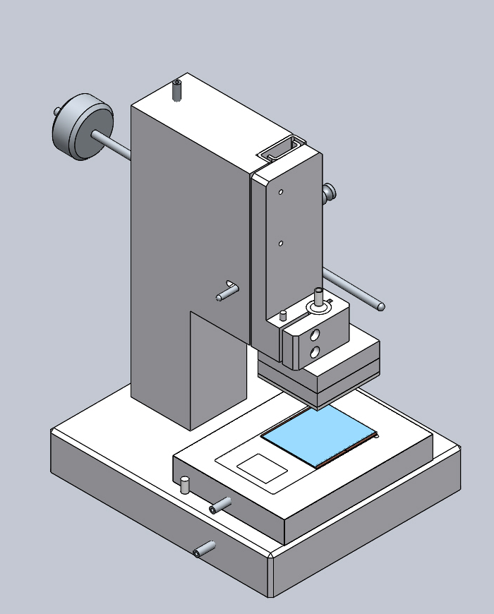
Quad vacuum chuck with quad placed on the glue stamping unit
Located using dowels and vacuumed in place.

Slide 11
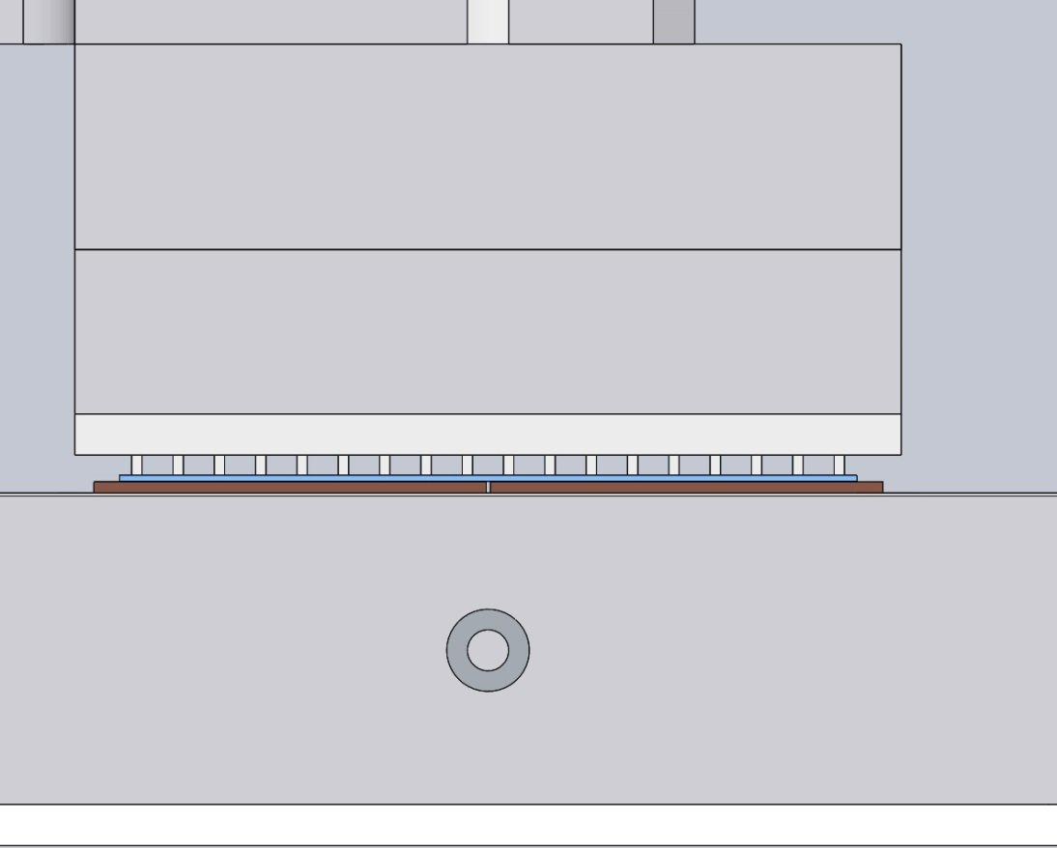
Glue pattern needs to be optimised will probably need several trials

Slide 12
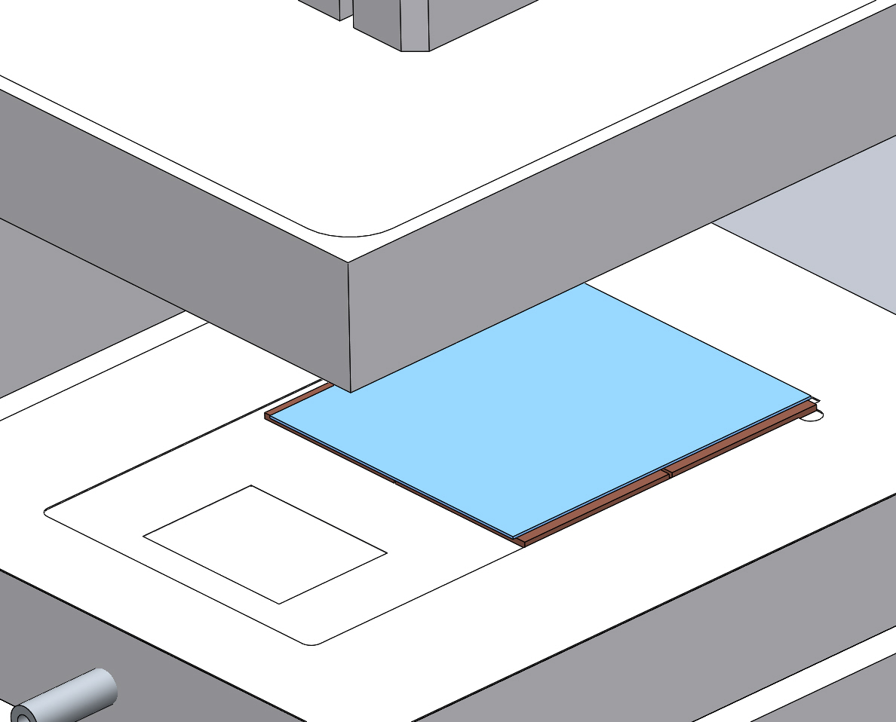

Slide 13
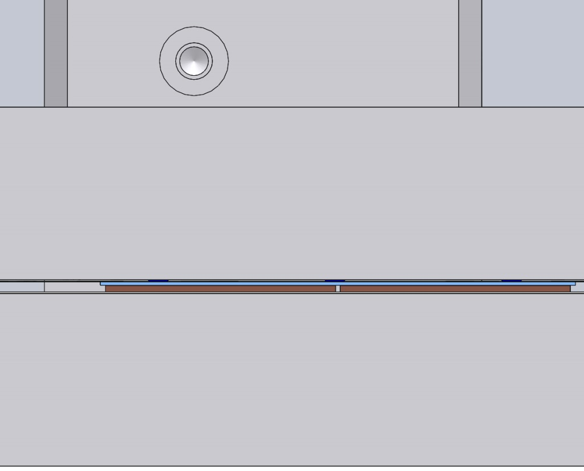
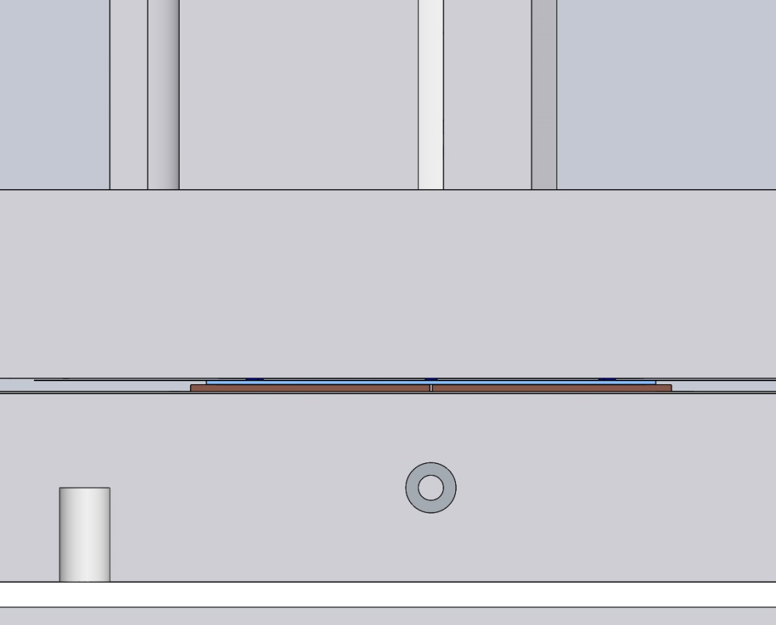
Flex is on the quad at this point we can either leave at room temp to cure or heat to accelerate curing

Slide 14
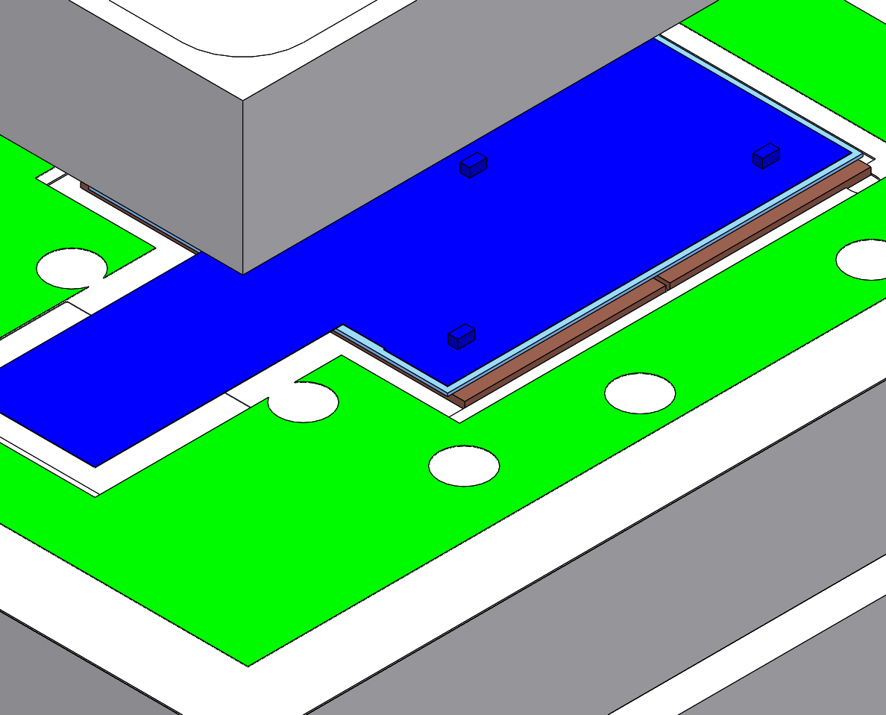
In addition to the straight forward apply and leave there is the option to release the top chuck and reposition slightly

