Slide 1
ATLAS pixel module assembly flow

Slide 2
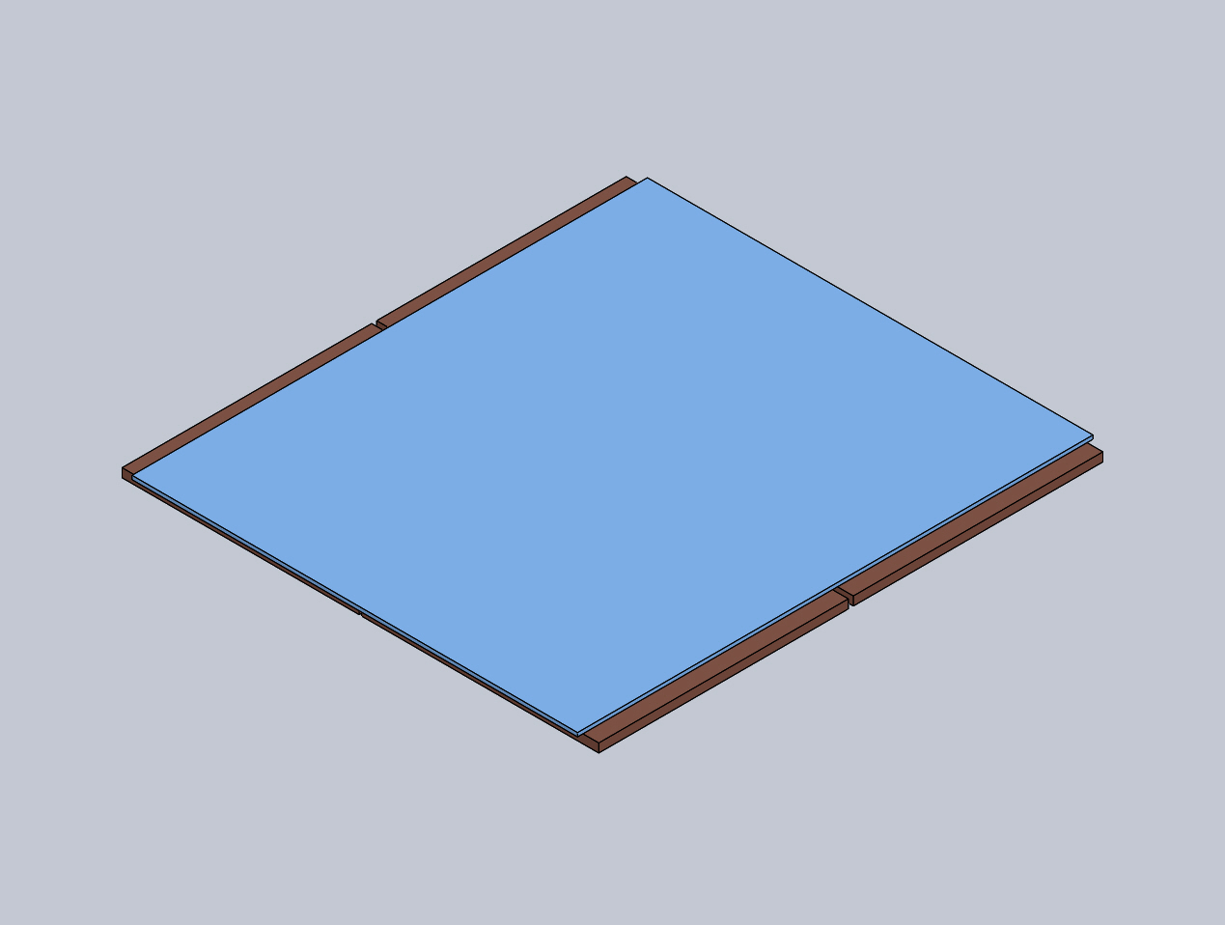
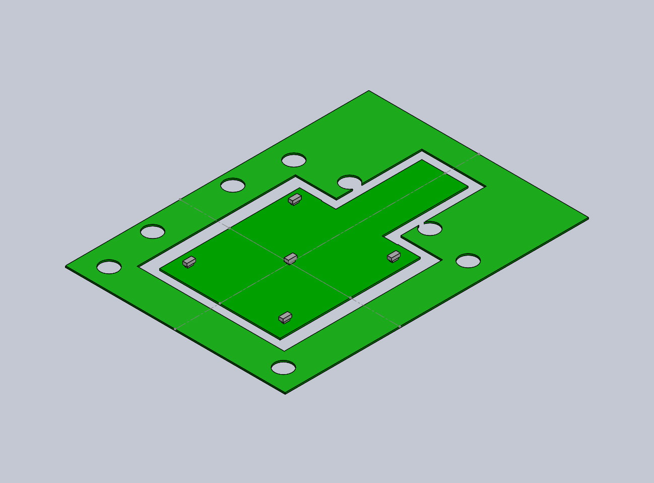
Raw materials
Pixel assembly
Flex – with SMD
MUX and PSPP chips
Data cable (could use a connector or soldered)

Slide 3
Overview of module production
Flex arrives - test
Glue MUX and PSPP chips
Wirebond MUX and PSPP chips
Test electrically MUX and PSPP chip on flex
Glue flex to pixel assembly
Wirebond flex to pixel assembly
Test electrically pixel assembly

Slide 4
Glue attach MUX and PSPP chips
Use a jig to place flex in defined place.
Use a tool to apply defined glue quantity
Use a jig to place glue dot in a defined place
Use a tool to place chips in defined place
Use a tool to apply pressure while chip glue cures (could be UV?)

Slide 5
5. Use a similar tool as in 4 with vacuum to pick-up the CHIP and place

Slide 6
Wirebond MUX and PSPP chip
Use a jig that holds several Flex hybrids at the same time.
Hold the flex down with vacuum under the body of the flex
Support bond pads and ASICs underneath for bondability
Usable H&K710 Bonding area is 150 x 180 mm – table can be slightly larger
Flex in frame is 70 x 90 mm
Should be able to bond 4 flexes in a single pass

Slide 7
Example flex bond jig for MUX and PSPP bonding
Vacuum jig
Bondable area
Flex

Slide 8
Testing MUX and PSPP chip
Ideally test the MUX and PSPP chip as installed to confirm that the process worked.
If connector present on the tab for power and DCS can use this
Prefer to probe pads
For data use bond pads on the flex to inject signal and readout signal
Use a jig with pogo-pins (spring pins)
170um pitch is possible, -1dB at 9.8GHz, 0.2A DC current
http://kita-usa.net/wp-content/uploads/2015/09/0.17-PITCH-X-4.7-LG.png
Use bigger pins for high current connections, 500um pitch, 4.4A DC current
http://kita-usa.net/high-current-high-temperature-0-50mm-pitch/
Design flex for testing
Test fixture will be mounted on Z travel arm. Flex held on vacuum jig
Test fixture lowered into contact with the flex for testing
Test one at a time

Slide 10
Glue flex to pixel assembly
Use a stamp method to transfer glue from glue bath to pixel assembly
Pick up pixel flex and lower onto pixel assembly
Several stage process required to obtain required accuracy
Based on FEI4 wire bond pad pitch of 150um
Would want less than ¼ pitch miss-alignment – Just made this up. Needs really to be based on an angle and distance for the bond pads
Requires 37um alignment accuracy
Rotational accuracy:
Assume want d < pitch /4 = 37um
$\sin{θ}=\frac{d}{20mm}→ θ<{0.1}^{o}$
Want l < 100um
$\sin{θ}=\frac{l}{20mm}→ θ<{0.29}^{o}$
20mm
d
$$θ$$
l

Slide 11
Equipment
Use the same base design of Z-axis tower through-out
Use vacuum chucks to hold the flex and pixel assembly
Vacuum chucks are identical except for front surface
Use laser cut s/s shims glued to the front of the chucks to position the flex & pixel assembly
Use stamper to apply glue to the pixel assembly

Slide 12
Process flow
Load pixel assembly into pixel assembly vacuum chuck
Load flex assembly into flex vacuum chuck
Make up glue bath
Load stamp with glue
Apply glue to pixel assembly
Position “glued” pixel assembly under flex
Pick up flex with Z-axis stage
Lower flex onto assembly and allow to cure

Slide 13
Load pixel assembly into vacuum chuck
Use Z-axis tower with pixel flex vacuum head
Place pixel flex into pixel flex vacuum chuck.
Push flex into corner, with vacuum pen, to accurately position flex against s/s shim
If using a frame then need to be sure that the flex to frame connection does not buckle – needs some trails
Place pixel flex chuck under z-axis stage
Lower flex vacuum head to pick up pixel flex

Slide 14
Glue application process
Glue to stamper
Glue Stamper to pixel assembly
Use Z-axis tower with stamper
Place vacuum chuck with glue tray below tower
Assume that glue is of defined height via use of shims
Lower stamper into tower to wet with glue
Raise stamper and remove glue chuck
Place pixel assembly into pixel assembly vacuum chuck.
Push assembly into corner, with vacuum pen, to accurately position assembly against s/s shim
Place pixel assembly chuck under z-axis stage
Lower glue loaded stamper onto pixel assembly and raise

Slide 15
Flex to pixel assembly joining
Use Z-axis tower with pixel flex attached
Place pixel assembly with glue applied below tower
Lower tower to bring pixel flex into contact with pixel flex.
Check with microscope that the alignment between ROIC bond pads and flex bond pads is as required.
This might require the removal of the flex vacuum check.
Performed by turning off vacuum chuck vacuum and raising the Z-tower
Ideally inspection should be possible without chuck removal
Would need to remove flex frame
If required use tweezers to re-align flex on the module
Apply pressure with Z-axis tower until glue is cured
Increase temperature to 60C to accelerate cure
Will need to confirm that this does not distort module

Slide 16
Wirebond of module
Use same 4 module jig to wire bond 4 modules at once
Keeping the frame until module mounting will aid handling
Use a cutter to release the module from the frame
Same Z-axis tool
Similar vacuum jig to flex assembly jig to position the module.
Requires metal face under the flex tabs
Z-axis tool has cutter attachment

