Slide 1

CERN Testbeam overview
September 2012
Dean Forshaw

Slide 2
Test beam period’s: Part I 10th – 14th (8am) September
and Part II 27th – 30th September
Test beam had problems like usual!!! First 2 days no data was taken.
Telescope had to be set back up, alignment of whole telescope and assembly of the cool box and holding arm. Many parts had been moved to CERN’s main site for some reason.
First day + ½ of second , no beam!!!
Beam profile settings off when finally got beam, had to wait for expert to come and fix the target and wobbler settings

Slide 3
New beam profile settings meant that the telescope rate went down from 1kHz --> 400/500Hz, on average.
Poor shifter turn out for shift’s. Night shifts where officially canceled, but I stayed up changing dry ice, watch data etc…...
Paul helped in the second testbeam period.
Data greater than 3 Million events where taken, usually when I went to sleep and left system taking data.
Frequent error and warnings, meant that the run control had to be restarted frequently to avoid data corruption.

Slide 4
Devices to test
Devices:
  VTT10 – 500x25um Pixels
  VTT13 – SE device only just bonded up before test beam
  VTT5 – Standard FEI4 Assembly
  MSS02 – NinN – old assembly – device not pre-selected before bumping to chip. This is to be used as a ref plane only.
PART I :
VTT13 – Broke 2 wire bonds during first warm up after be re-tuned in the telescope at -50deg, no data was taken
VTT10 – All wire bonds were ripped off when the aluminium heat plate came away (partially) from the daughter board.
PART II:
VTT10 – Still not working, mike went away on holiday, as did Ian McGill at CERN.
VTT5 – Won’t bias anymore

Slide 5
Part I run conditions
Data was eventually taken at:
In the remaining 2 days for the first testbeam period
Data was taken only with MSS02 as reference and VTT5.
Batch label | R (X vs Y rotation) | Phi (X vs Z Tilt) | 3200e | 1600e
Batch 1a | 0 | 0 | ~ 3 Million | ~ 3 Million
Batch 1b | 0 | 15 | ~ 3 Million | ~ 3 Million
Batch 1c | 85 | 0 | ~ 3 Million | ~ 3 Million
Batch 1d | 85 | 15 | ~ 3 Million | ~ 3 Million

Slide 6
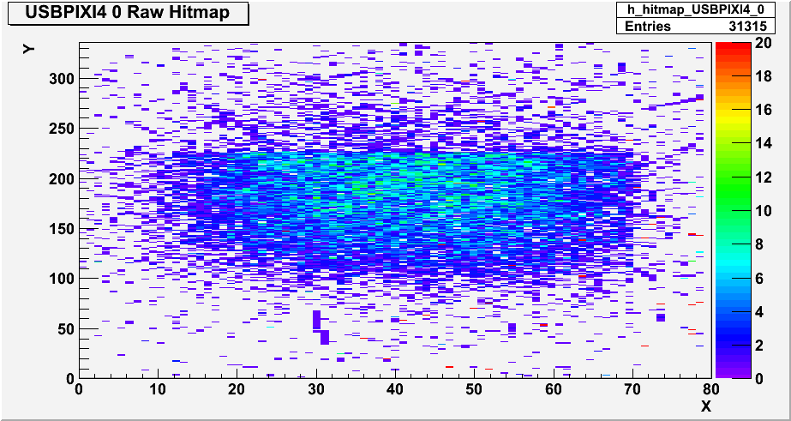
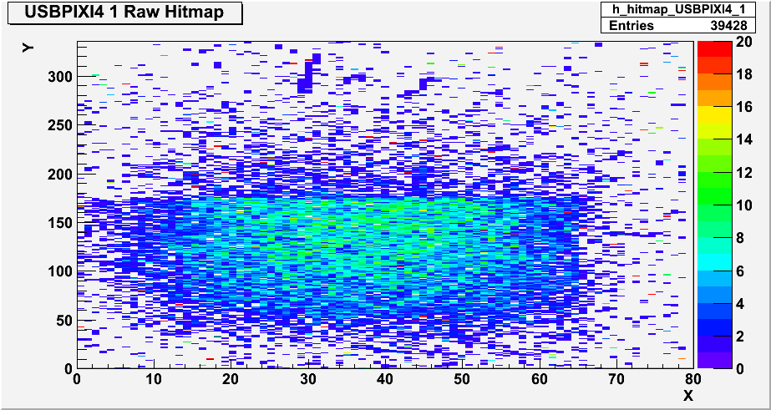
Part I run conditions
VTT5
MSS02

Slide 7
Part II run conditions
Data was taken only with MSS02 as reference and VTT13.
VTT5 would not bias
Had to transfer data from PC to DOS and GRID to free up some space for more data. This took about 1 day.
Batch label | R (X vs Y rotation) | Phi (X vs Z Tilt) | 3200e | 1600e | 1200e
Batch 3a | 0 | 0 | ~ 3 Million | ~ 3 Million | ~ 3 Million
Batch 3b | 0 | 15 | ~ 3 Million | ~ 3 Million | ~ 3 Million
Batch 3c | 15 | 0 | ~ 3 Million | ~ 3 Million | ~ 2 Million

Slide 8
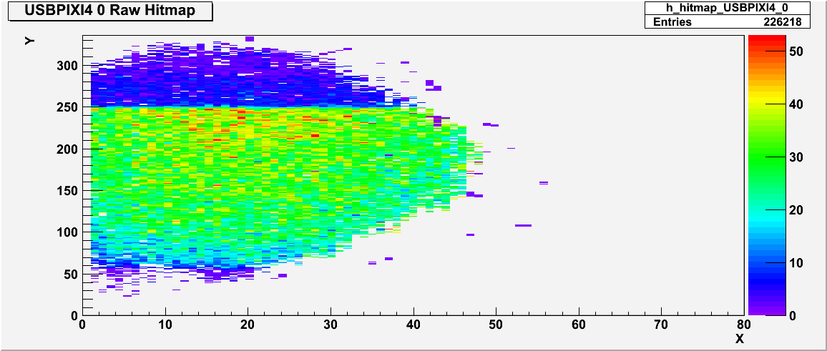
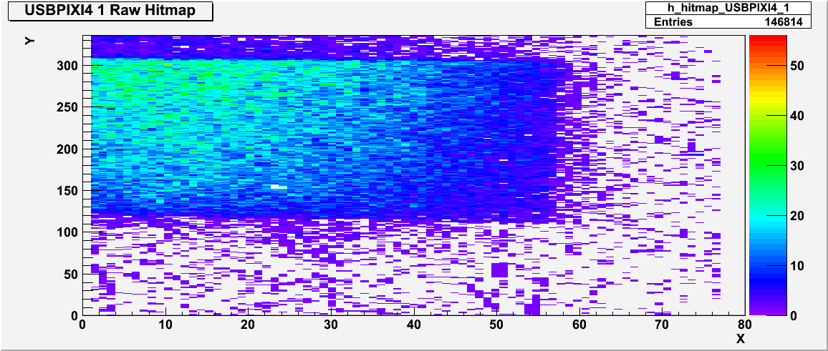
Part II run conditions
VTT13
MSS02

Slide 9
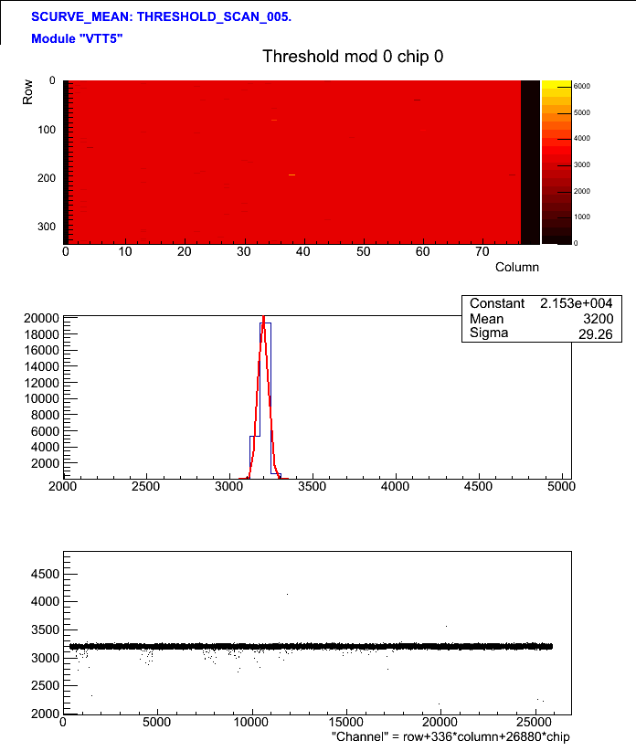
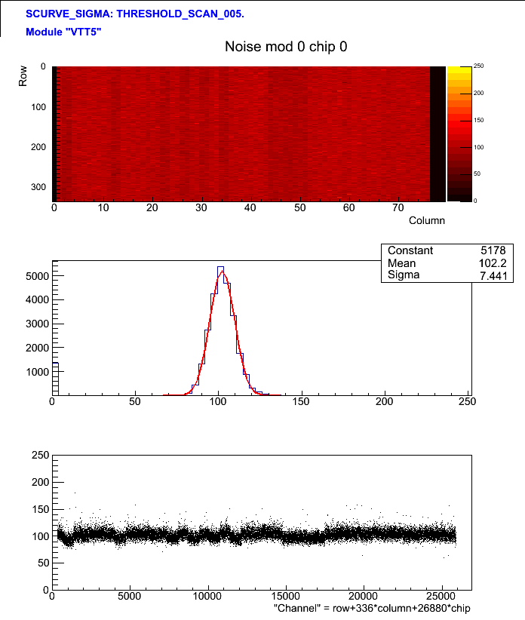
Devices – VTT5 (std) initial characteristics

Slide 10
Devices – VTT5 (std) initial characteristics
VTT5 acted fine in the lab and at the start of the testbeam
Over time its IV’s worsened
In telescope cooled to -50/-40 currents sometime hit the trips for the telescope DCS system, Had to put a high compliance, ~5mA.
Most of the time current was very low, but current spikes occurred only in this device in multiple HV channels.
If temp was fine, device was just re-biased and data taking continued.
Device won’t bias any more, in the telescope or in the lab. There is no visible damage

Slide 11
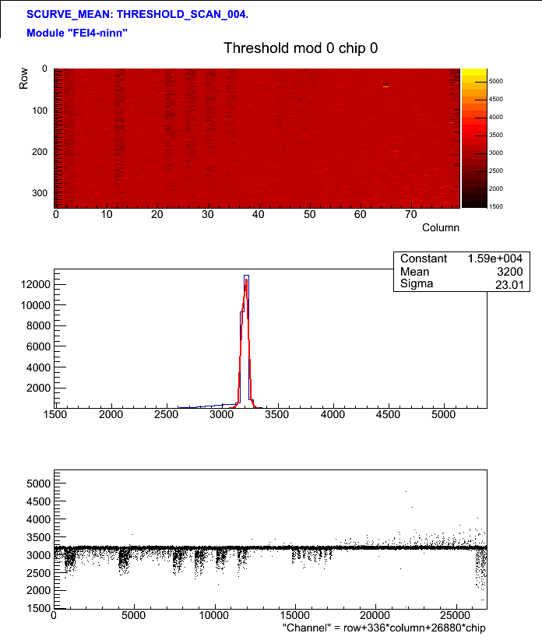
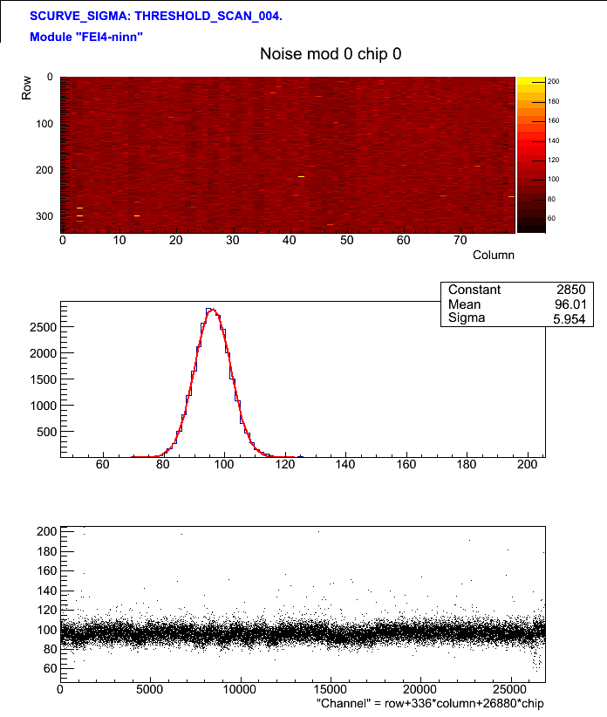
Devices – MSS02 initial characteristics

Slide 12
Devices – MSS02 initial characteristics

