Slide 1
UK Assembly IV Update
UK Pixel Weekly Meeting
30/5/2013

Slide 2
Wafer 2433-14, UK Quad 7. 450um edge and Quad 5, production
Better breakdown performance
> 400V post – assembly
< 200V pre - assembly
Lower leakage
1.45x10-7 @ 130V Post Assembly
6.8x10-7 @ 130V Pre Assembly
(see look-up table later)
Higher Leakage observed prior to breakdown
1.38x10-5 @ 130V Post Assembly
6.8x10-6 @ 130V Pre Assembly
(see look-up table later)

Slide 3
Single assembly SC1, Wafer 2615-19
Lower leakage observed
8.9x10-9 @ 130V Post Assembly
1.1x10-8 @ 130V Pre Assembly
(see look-up table later)

Slide 4
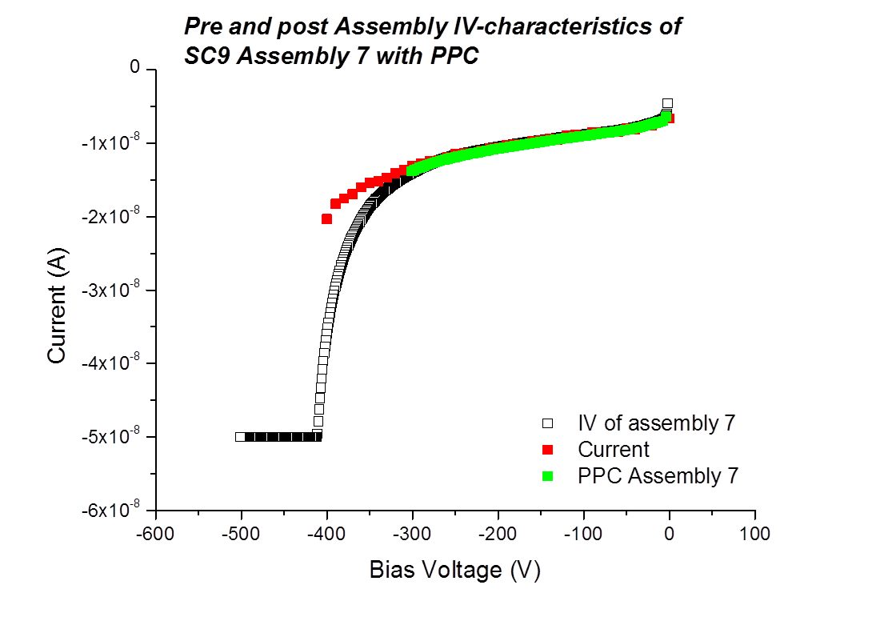
Comparison of Assembly IV after Paralene Coating
Paralene coating process does not appear to affect performance

Slide 5
Assembly Look-up table
Assembly ID | Pre - Assembly |  | Post Assembly
 | Bias (V) | Leakage (A) | Bias(V) | Leakage (A)
Quad 2 | -5 | 2.95x10-7 | - | -
 | -130 | 4.15x10-7
Quad 7 | -5 | 3.15x10-7 | -5 | 1.22x10-8
 | -130 | 6.8x10-7 | -130 | 1.45x10-7
Quad 5 | -5 | 2.96x10-7 | -5 | 6.0x10-8
 | -130 | 1.06x10-6 | -130 | -1.38x10-5
SC1 | -10 | 8.47x10-9 | -11 | 5.6x10-9
 | -130 | 1.1x10-8 | -131 | 8.9x10-9
SE3 Assembly 2 | -10V | 7.6x10-9 | -10 | 9.64x10-9
 | -130 | 2.03x10-8 | -130 | compliance
SE4 Assembly 1 | -10V | 6.1x10-9 | -10 | 7.14x10-9
 | -105V | 1.27x10-8 | -130 | 1.9x10-9

Slide 6
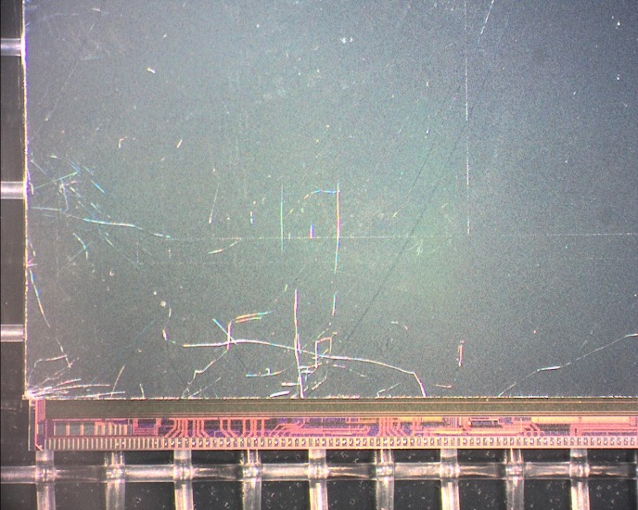
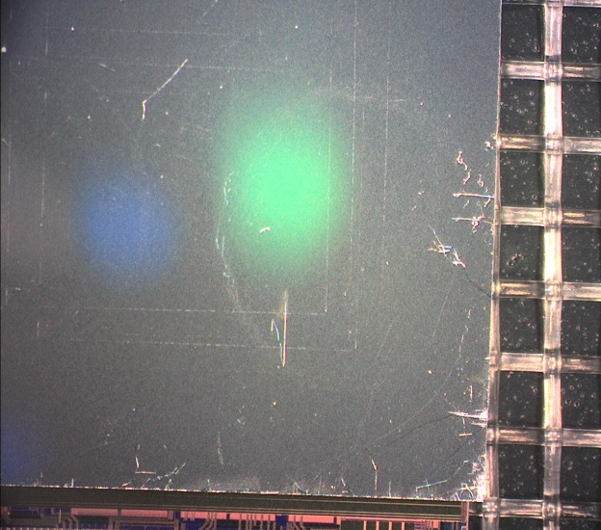
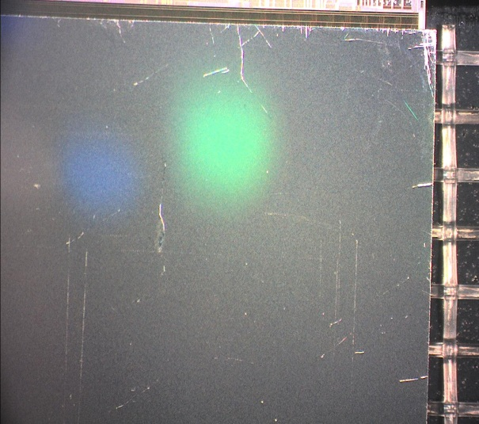
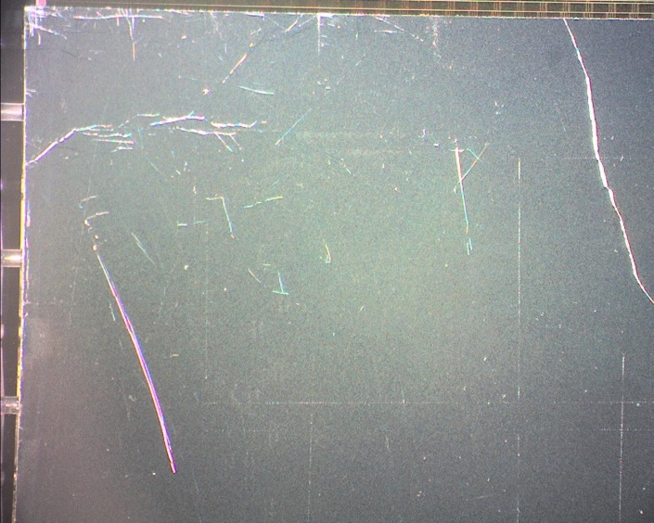
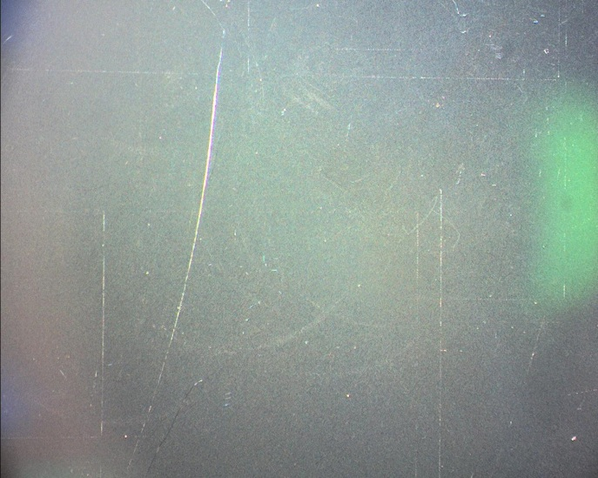
Defect Gallery of Quad 2

Slide 7
Summary and to do
IV characteristics of the assemblies imply that the bump bonding process is working well
Some analysis of the assemblies not performing well is on-going
Higher breakdown voltages and lower leakage currents (particularly on quad assemblies) is observed
The paralene coating process does not appear to affect the assembly performance
Complete population of Assembly look-up table
Compile defect analysis of failed and low performing assemblies

